Slide 1
Week?12🦃
graphs
amazing stackoverflow answer
boggle?
gradient descent

Slide 2
graphs

Slide 3
graph

Slide 4
a directed graph is a super general linked list
a node in a graph has references to any number of other nodes
nodes (vertices) are drawn as circles
references (edges) are drawn as arrows

Slide 5
an undirected graph has line segments instead of arrows

Slide 6
is it a graph?

Slide 7
time for everyone's favorite home game...

Slide 8
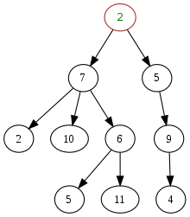
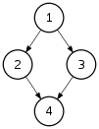
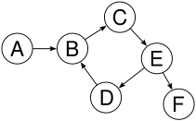
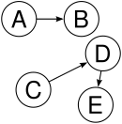

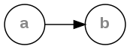
is it a tree?
graph
yes
yes
tree rules
one node with zero parents
no node with more than one parent
no cycles
is connected
yes
yes
yes
yes
yes

Slide 9
yes

Slide 10
examples

Slide 11
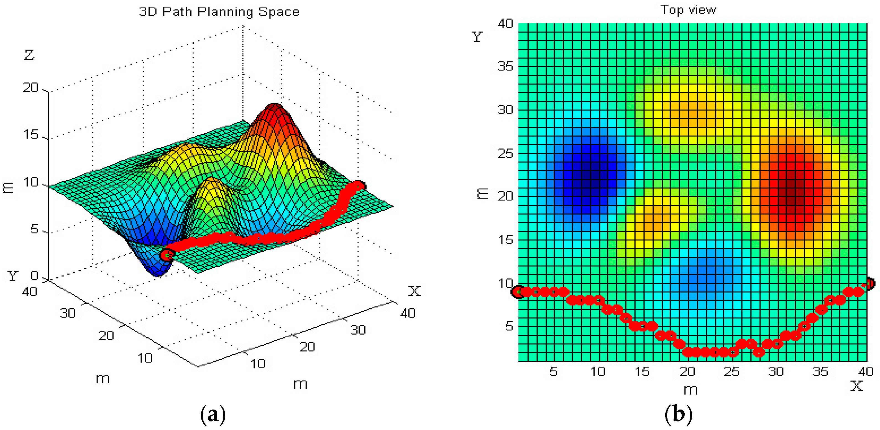

path planning

Slide 12
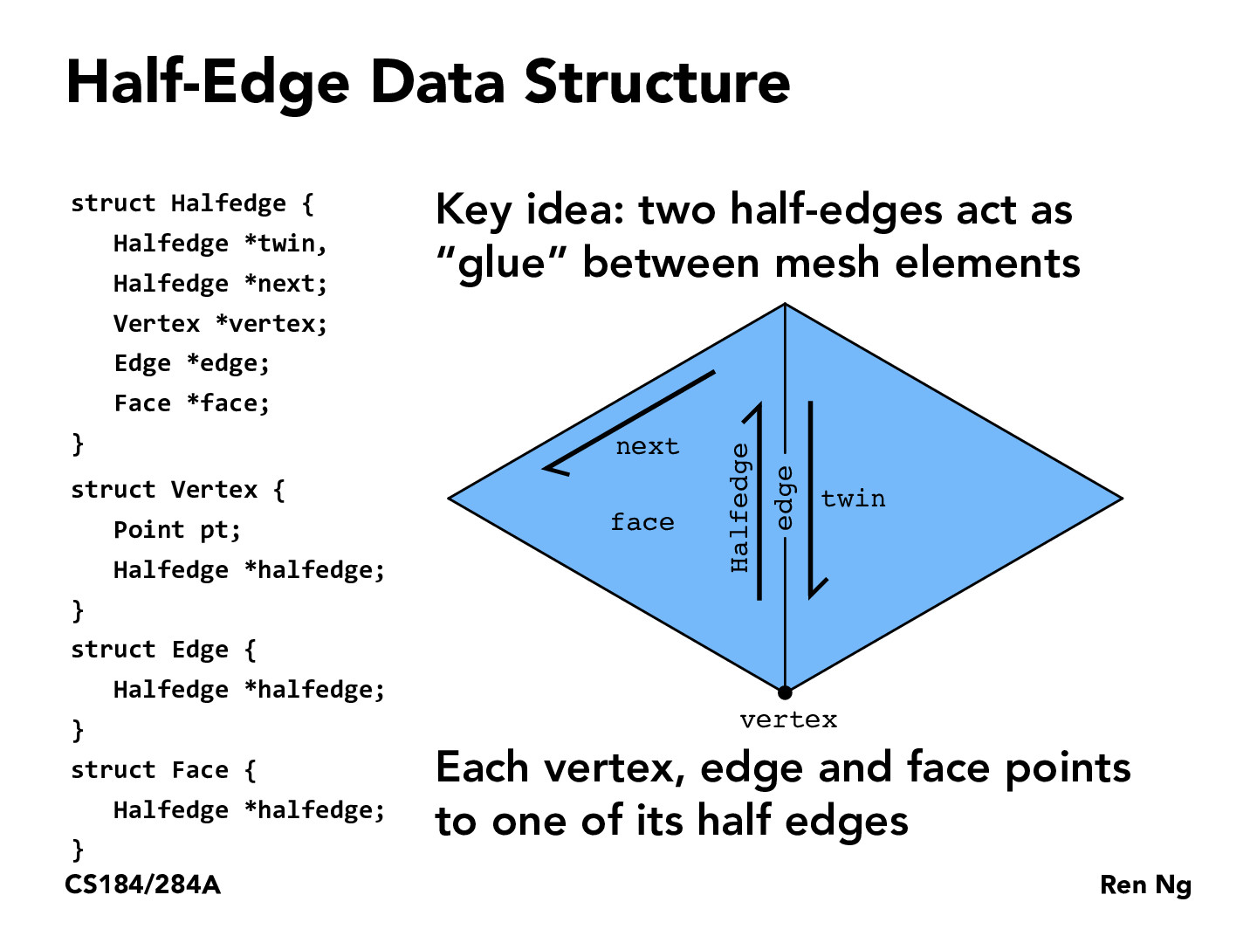
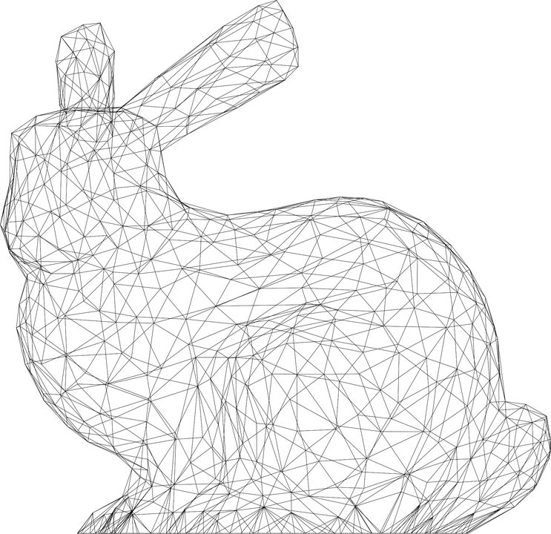

Slide 13
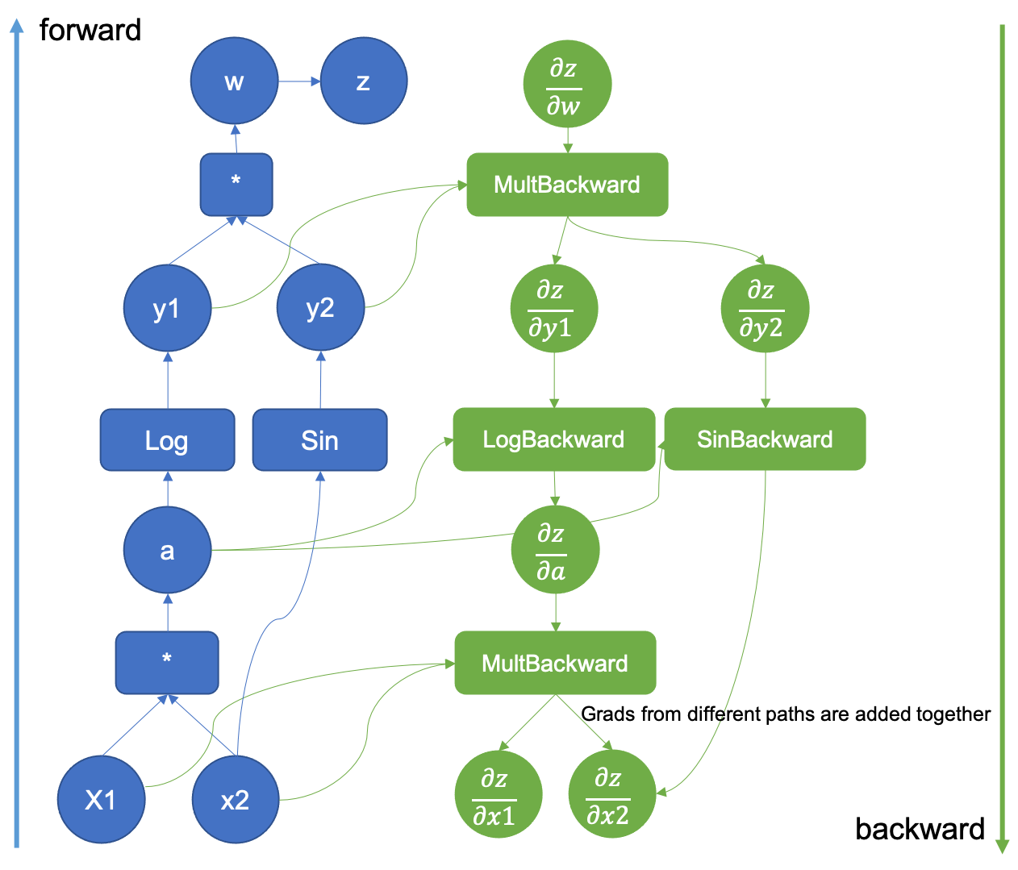

computational
graph
(to take derivatives of deep nets)

Slide 14

Yeah that's pretty much right --Mark
Is this an accurate quote?
--Jim
Yeah, sure
--Mark

Slide 15
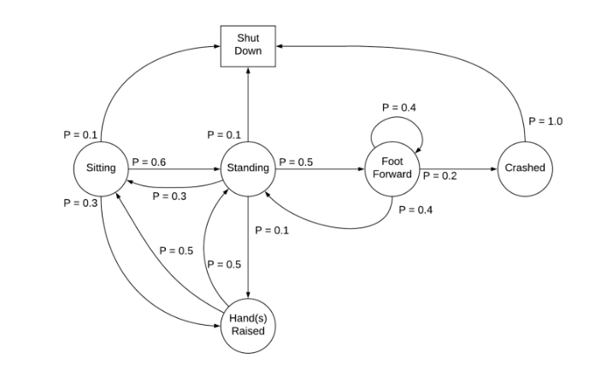
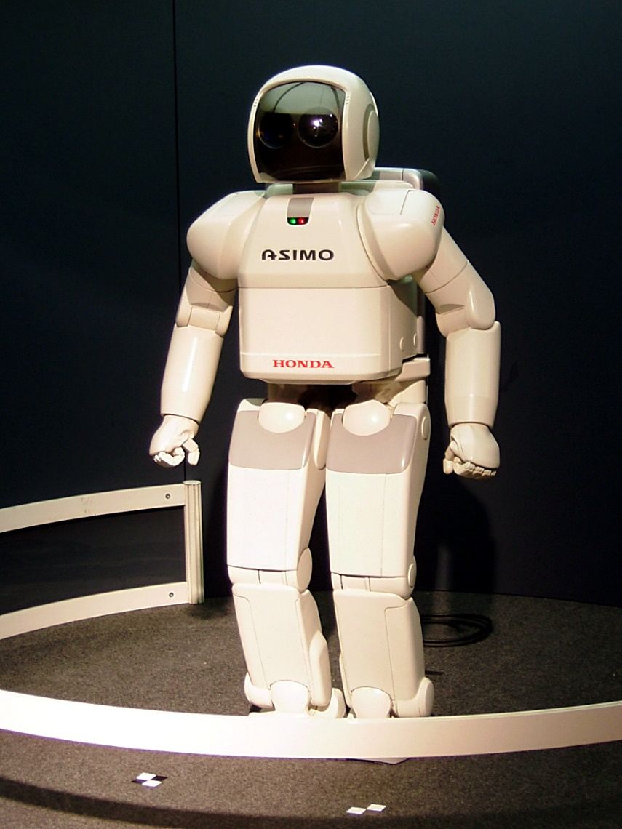
Markov Decision Process

Slide 16
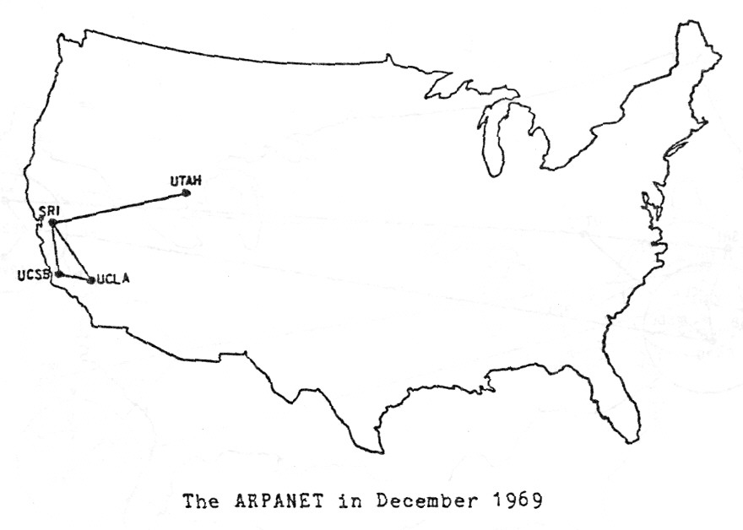

Slide 17

Present day, from Opte The Internet: 1997 - 2021. VIDEO: BARRETT LYON/THE OPTE PROJECT

Slide 18
directed graph representations (how do i store The Data?)

Slide 19
0
1
3
2

Slide 20
Object-Oriented list of nodes
class Graph {
ArrayList<Node> nodes;
Graph() { ... }
}
class Node {
ArrayList<Node> neighbors;
Node() { ... }
}
Graph graph = new Graph();
graph.nodes.add(new Node());
graph.nodes.add(new Node());
graph.nodes.add(new Node());
graph.nodes.add(new Node());
graph.nodes.get(1).neighbors.add(graph.nodes.get(0));
graph.nodes.get(1).neighbors.add(graph.nodes.get(3));
graph.nodes.get(2).neighbors.add(graph.nodes.get(3));
graph.nodes.get(3).neighbors.add(graph.nodes.get(0));
0
1
3
2

Slide 21
Object-Oriented list of nodes
class Graph {
ArrayList<Node> nodes;
Graph() { ... }
}
class Node {
ArrayList<Node> neighbors;
Node() { ... }
}
Graph graph = new Graph();
graph.addNode();
graph.addNode();
graph.addNode();
graph.addNode();
graph.addEdge(1, 0);
graph.addEdge(1, 3);
graph.addEdge(2, 3);
graph.addEdge(3, 0);
0
1
3
2

Slide 22
list of lists
ArrayList<ArrayList<Integer>> graph = new ArrayList<>();
graph.add(new ArrayList<>());
graph.add(new ArrayList<>());
graph.add(new ArrayList<>());
graph.add(new ArrayList<>());
graph.get(1).add(0);
graph.get(1).add(3);
graph.get(2).add(3);
graph.get(3).add(0);
0
1
3
2

Slide 23
list of edges
class Edge {
int i;
int j;
Edge(int i, int j) { ... }
}
int numNodes = 4;
ArrayList<Edge> graph = new ArrayList<>();
graph.add(new Edge(1, 0));
graph.add(new Edge(1, 3));
graph.add(new Edge(2, 3));
graph.add(new Edge(3, 0));
0
1
3
2

Slide 24
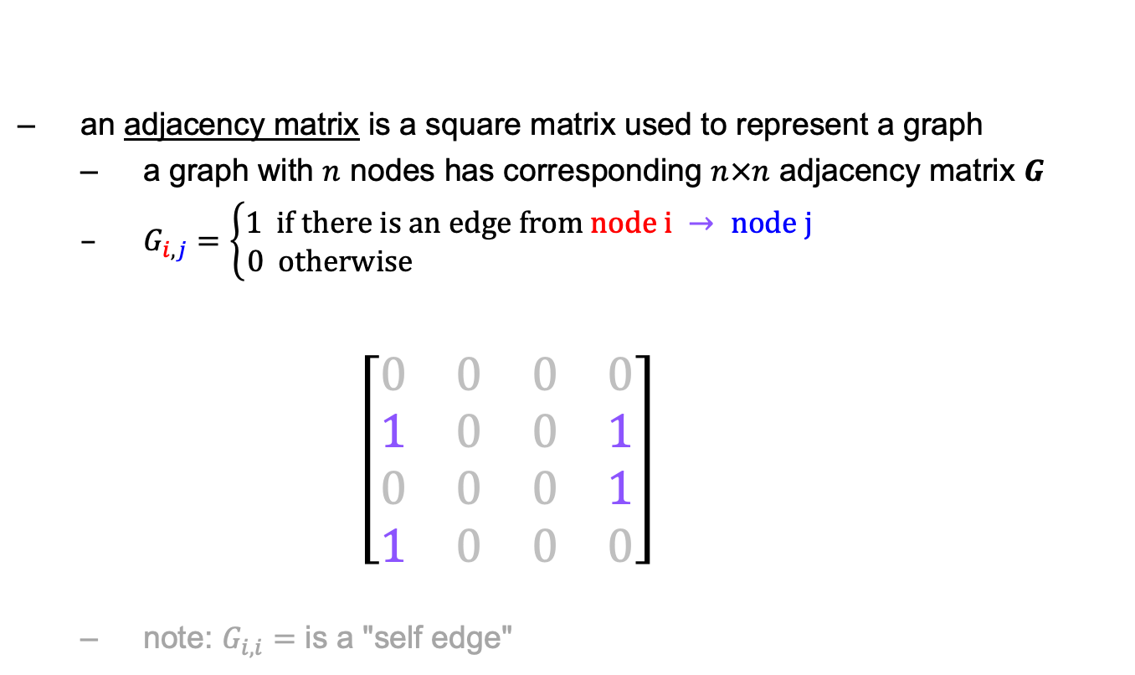
math: adjacency matrix
an adjacency matrix is a square matrix used to represent a graph
a graph with $n$ nodes has corresponding $n×n$ adjacency matrix $G$
$G_{i,j}=\left\{\begin{aligned}1 if there is an edge from node i → node j \\ 0 otherwise \end{aligned}\right.$ $\left[\begin{matrix}0 & 0 & 0 & 0 \\ 1 & 0 & 0 & 1 \\ 0 & 0 & 0 & 1 \\ 1 & 0 & 0 & 0\end{matrix}\right]$
note: $G_{i,i}=$ is a "self edge"
$$\begin{matrix}0 & 1 & 2 & 3\end{matrix}$$
0
1
$$\begin{matrix}0 \\ 1 \\ 2 \\ 3\end{matrix}$$
3
2

Slide 25
dense matrix at 2D array
int[][] graph = new int[4][4];
graph[1][0] = 1;
graph[1][3] = 1;
graph[2][3] = 1;
graph[3][0] = 1;
$$\begin{matrix}0 & 1 & 2 & 3\end{matrix}$$
0
1
$$\begin{matrix}0 \\ 1 \\ 2 \\ 3\end{matrix}$$
$$\left[\begin{matrix}0 & 0 & 0 & 0 \\ 1 & 0 & 0 & 1 \\ 0 & 0 & 0 & 1 \\ 1 & 0 & 0 & 0\end{matrix}\right]$$
3
2

Slide 26
dense matrix as 1D array
int[] graph = new int[4 * 4];
graph[4 * 1 + 0] = 1;
graph[4 * 1 + 3] = 1;
graph[4 * 2 + 3] = 1;
graph[4 * 3 + 0] = 1;
$$\begin{matrix}0 & 1 & 2 & 3\end{matrix}$$
0
1
$$\begin{matrix}0 \\ 1 \\ 2 \\ 3\end{matrix}$$
$$\left[\begin{matrix}0 & 0 & 0 & 0 \\ 1 & 0 & 0 & 1 \\ 0 & 0 & 0 & 1 \\ 1 & 0 & 0 & 0\end{matrix}\right]$$
3
2
$$\left[\begin{matrix}0 & 0 & 0 & 0 & 1 & 0 & 0 & 1 & 0 & 0 & 0 & 1 & 1 & 0 & 0 & 0\end{matrix}\right]$$
$$\begin{matrix}(0, 0) & (0, 1) & (0, 2) & (0, 3) & (1, 0) & (1, 1) & (1, 2) & (1, 3) & (2, 0) & (2, 1) & (2, 2) & (2, 3) & (3, 0) & (3, 1) & (3, 2) & (3, 3)\end{matrix}$$

Slide 27
sparse matrix
class Entry {
int row;
int col;
int val;
Entry(...) { ... }
}
ArrayList<Entry> graph = new ArrayList<>();
graph.add(new Entry(1, 0, 1));
graph.add(new Entry(1, 3, 1));
graph.add(new Entry(2, 3, 1));
graph.add(new Entry(3, 0, 1));
$$\begin{matrix}0 & 1 & 2 & 3\end{matrix}$$
0
1
$$\begin{matrix}0 \\ 1 \\ 2 \\ 3\end{matrix}$$
$$\left[\begin{matrix}0 & 0 & 0 & 0 \\ 1 & 0 & 0 & 1 \\ 0 & 0 & 0 & 1 \\ 1 & 0 & 0 & 0\end{matrix}\right]$$
3
2

Slide 28
Week11a
WARMUP
What does this print?
PRINT(0.1 + 0.2);
PRINT(SQRT(2.0) * SQRT(2.0));
the Fibonacci sequence
recursion
dynamic programming
🦜🦜🦜🦜🦜🦜🦜🦜🦜🦜🦜
🍉
WARMUP
What is F₇?
F₀ = 0
F₁ = 1
F_{k} = F_{k - 1} + F_{k - 2}

Slide 29
what are these?
🍉

Slide 30

the

Slide 31
👼

Slide 32
the Fibonacci sequence

Slide 33


Slide 34
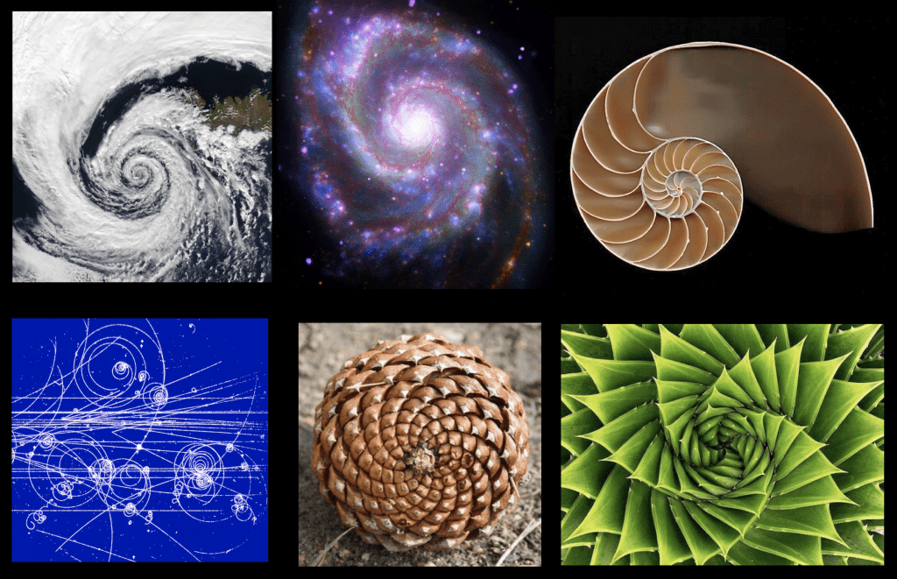

Slide 35
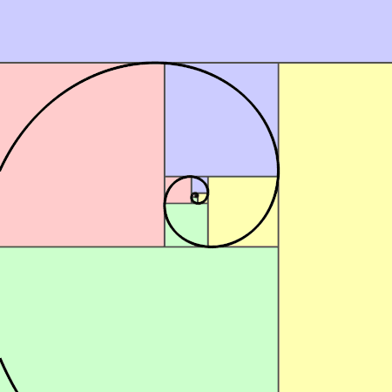

Slide 36
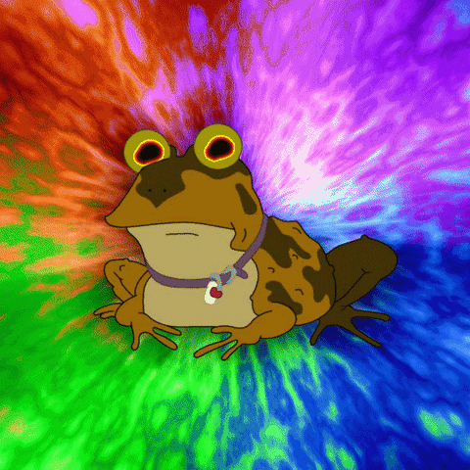

Slide 37
// F_0 = 0
// F_1 = 1
// F_2 = F_1 + F_0 = 1 + 0 = 1
// F_3 = F_2 + F_1 = 1 + 1 = 2
// F_4 = F_3 + F_2 = 2 + 1 = 3
// F_5 = F_4 + F_3 = 3 + 2 = 5
// F_6 = F_5 + F_4 = 5 + 3 = 8
// F_7 = F_6 + F_5 = 8 + 5 = 13
// ...

Slide 38
recursion

Slide 39
review: recursion basics

Slide 40
recursion
a recursive function is a function that calls itself
each call must make progress towards a base case (when the function finally returns without calling itself)
✨ when in doubt, try something like zero for your base case
class Main {
static int digitSum(int n) {
if (n == 0) {
return 0;
}
return digitSum(n / 10) + (n % 10);
}
public static void main(String[] arguments) {
PRINT(digitSum(256)); // 13
}
}

Slide 41
static int digitSum(int n) {
if (n == 0) {
return 0;
}
return digitSum(n / 10) + (n % 10);
}
return 0;
return digitSum(0) + 2;
return digitSum(2) + 5;
return digitSum(25) + 6;
int a = digitSum(256);

Slide 42
static int digitSum(int n) {
if (n == 0) {
return 0;
}
return digitSum(n / 10) + (n % 10);
}
return 0;
return digitSum(0) + 2;
return digitSum(2) + 5;
return digitSum(25) + 6;
int a = digitSum(256);

Slide 43
static int digitSum(int n) {
if (n == 0) {
return 0;
}
return digitSum(n / 10) + (n % 10);
}
return 0 + 2;
return digitSum(2) + 5;
return digitSum(25) + 6;
int a = digitSum(256);

Slide 44
static int digitSum(int n) {
if (n == 0) {
return 0;
}
return digitSum(n / 10) + (n % 10);
}
return 2;
return digitSum(2) + 5;
return digitSum(25) + 6;
int a = digitSum(256);

Slide 45
static int digitSum(int n) {
if (n == 0) {
return 0;
}
return digitSum(n / 10) + (n % 10);
}
return 2;
return digitSum(2) + 5;
return digitSum(25) + 6;
int a = digitSum(256);

Slide 46
static int digitSum(int n) {
if (n == 0) {
return 0;
}
return digitSum(n / 10) + (n % 10);
}
return 2 + 5;
return digitSum(25) + 6;
int a = digitSum(256);

Slide 47
static int digitSum(int n) {
if (n == 0) {
return 0;
}
return digitSum(n / 10) + (n % 10);
}
return 7;
return digitSum(25) + 6;
int a = digitSum(256);

Slide 48
static int digitSum(int n) {
if (n == 0) {
return 0;
}
return digitSum(n / 10) + (n % 10);
}
return 7;
return digitSum(25) + 6;
int a = digitSum(256);

Slide 49
static int digitSum(int n) {
if (n == 0) {
return 0;
}
return digitSum(n / 10) + (n % 10);
}
return 7 + 6;
int a = digitSum(256);

Slide 50
static int digitSum(int n) {
if (n == 0) {
return 0;
}
return digitSum(n / 10) + (n % 10);
}
return 13;
int a = digitSum(256);

Slide 51
static int digitSum(int n) {
if (n == 0) {
return 0;
}
return digitSum(n / 10) + (n % 10);
}
return 13;
int a = digitSum(256);

Slide 52
static int digitSum(int n) {
if (n == 0) {
return 0;
}
return digitSum(n / 10) + (n % 10);
}
int a = 13;

Slide 53
fin.

Slide 54
⚠️ recursion hazard 1 repeated computation

Slide 55
🐌 example: slow very slow fibonnaci (couldn't we just use a for loop...?)
// F_0 = 0
// F_1 = 1
// F_2 = F_1 + F_0 = 1 + 0 = 1
// F_3 = F_2 + F_1 = 1 + 1 = 2
// F_4 = F_3 + F_2 = 2 + 1 = 3
// F_5 = F_4 + F_3 = 3 + 2 = 5
// ...
static long fib(long k) {
if (k == 0) { return 0; }
if (k == 1) { return 1; }
return fib(k - 1) + fib(k - 2);
}

Slide 56
fib(4)

Slide 57
(fib(3) + fib(2))

Slide 58
((fib(2) + fib(1)) + (fib(1) + fib(0)))

Slide 59
(((fib(1) + fib(0)) + fib(1)) + (fib(1) + fib(0)))

Slide 60
(((1 + 0) + 1) + (1 + 0))

Slide 61
((1 + 1) + 1)

Slide 62
(2 + 1)

Slide 63
3

Slide 64
fib(4)

Slide 65
fib(4)
fib(3)
fib(2)

Slide 66
fib(4)
fib(3)
fib(2)
fib(2)
fib(1)

Slide 67
fib(4)
fib(3)
fib(2)
fib(2)
fib(1)
fib(1)
fib(0)

Slide 68
fib(4)
fib(3)
fib(2)
fib(2)
fib(1)
1
0

Slide 69
fib(4)
fib(3)
fib(2)
1
fib(1)

Slide 70
fib(4)
fib(3)
fib(2)
1
1

Slide 71
fib(4)
2
fib(2)

Slide 72
fib(4)
2
fib(2)
fib(1)
fib(0)

Slide 73
fib(4)
2
fib(2)
1
0

Slide 74
fib(4)
2
1

Slide 75
3

Slide 76
🙂

Slide 77
☹️

Slide 78
3

Slide 79
fib(4)

Slide 80
fib(4)
fib(3)
fib(2)
fib(2)
fib(1)
fib(1)
fib(0)
😱 what about this picture does NOT spark joy?
fib(1)
fib(0)

Slide 81
fib(4)
fib(3)
fib(2)
fib(2)
fib(1)
fib(1)
fib(0)
fib(1)
fib(0)

Slide 82
we computed fib(2) from scratch two seperate times 😱 we are repeating computation! (what a waste 😞)

Slide 83
and for bigger n... there is (much) more repetition

Slide 84
F₆
F₄
F₅
F₂
F₃
F₃
F₄
F₀
F₁
F₁
F₂
F₁
F₂
F₂
F₃
F₀
F₁
F₀
F₁
F₀
F₁
F₁
F₂
F₀
F₁

Slide 85

F₆
F₄
F₅
F₂
F₃
F₃
F₄
F₀
F₁
F₁
F₂
F₁
F₂
F₂
F₃
F₀
F₁
F₀
F₁
F₀
F₁
F₁
F₂
F₀
F₁
🧠 who's that
big O runtime?

Slide 86
exponential 🙀

Slide 87
[fib(5), fib(36), fib(77) demo]

Slide 88
⚠️ recursion hazard 2 stack overflow

Slide 89
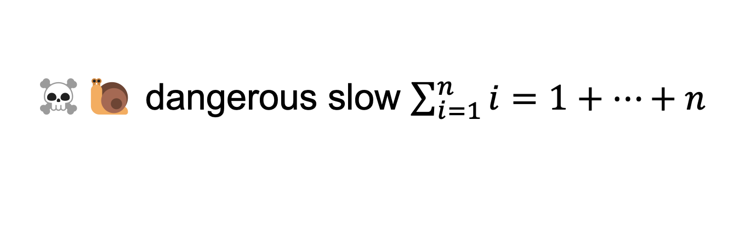
☠️🐌 dangerous slow $\sum_{i=1}^{n}{i}=1+…+n$
// 1 + ... + n
static int sum(int n) {
if (n == 0) return 0;
return n + sum(n - 1);
}

Slide 90
sum(100000)

Slide 91
sum(99999)
sum(100000)

Slide 92
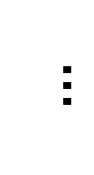
sum(0)
$$…$$
😱 what about this picture does NOT spark joy?
sum(99999)
sum(100000)

Slide 93
the height of the callstack is O(n) 😱 big n → stack overflow! 😞

Slide 94
[sum(100000) demo]

Slide 95
🧠 our depth-first binary (search) tree traversals were recursive... ...should we be worried about them overflowing the callstack?

Slide 96
no. (assuming your tree is ~balanced) callstack height for depth-first balanced binary tree traversal is log(n)
0
1
2
3
4 5
1 1 1 1 1 2 3
0 0 0 0 0 0 0 0 0 0 0
4
5
time

Slide 97
*additionally, some languages/compilers** have "tail-call optimization," which would prevent a stack overflow for sum(100000) **Java is not one of these languages (as our demo showed)

Slide 98
dynamic programming

Slide 99
dynamic programming is when you use the result of previous computation (this is a squishy definition)

Slide 100
F₆
F₄
F₅
F₂
F₃
F₃
F₄
F₀
F₁
F₁
F₂
F₁
F₂
F₂
F₃
F₀
F₁
F₀
F₁
F₀
F₁
F₁
F₂
F₀
F₁

Slide 101
F₆
F₅
F₄
F₄
F₃
F₃
F₂
F₂
F₁
F₁
F₀

Slide 102
F₆
F₅
F₄
F₄
F₃
F₃
F₂
F₂
F₁
F₁
F₀
🧠 who's that
big O runtime?

Slide 103
linear 🙂👍

Slide 104
memoization

Slide 105
memoization means storing the results of previous functions calls, so we don't have to repeat work when the function is called again

Slide 106
🙂 memoized fibonacci
static HashMap<Long, Long> table = new HashMap<>();
static long memoizedFib(long k) { // NOTE: long is an integer type
// that can store larger numbers than int
if (k == 0) { return 0; }
if (k == 1) { return 1; }
long Fkm1;
if (table.containsKey(k - 1)) {
Fkm1 = table.get(k - 1);
} else {
Fkm1 = memoizedFib(k - 1);
table.put(k - 1, Fkm1);
}
long Fkm2;
if (table.containsKey(k - 2)) {
Fkm2 = table.get(k - 2);
} else {
Fkm2 = memoizedFib(k - 2);
table.put(k - 2, Fkm2);
}
return Fkm1 + Fkm2;
}
🧠 what's the runtime of each call to memoizedFib(...)?
public static void main(...) {
int n = ...;
long a = memoizedFib(n);
long b = memoizedFib(n - 1);
long c = memoizedFib(n + 1);
}

Slide 107
int n = ...; long a = memoizedFib(n); // O(n) long b = memoizedFib(n - 1); // O(1) long c = memoizedFib(n + 1); // O(1)

Slide 108
👻 closed form fibonacci

Slide 109
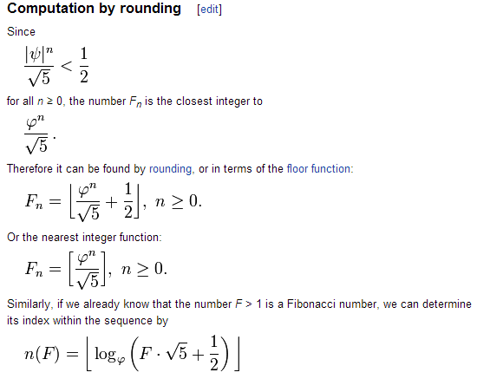

Slide 110
👻 approximate closed-form fibonnaci
// NOTE: Because of floating point error, this does not work for big n.
// (On my computer, returns wrong result for n > 70.)
static long closedFormFib(long n) {
final double goldenRatio = (1.0 + Math.sqrt(5.0)) / 2.0;
return Math.round(Math.pow(goldenRatio, n) / Math.sqrt(5.0));
}

Slide 111
exponentiation by squaring

Slide 112
note: there is actually a log(n) algorithm using matrices and "exponentiation by squaring" this algorithm does NOT have floating point problems (all numbers are integers)

Slide 113
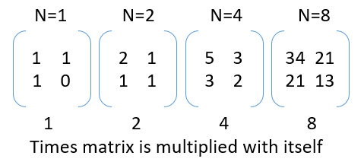

Slide 114
Week11b
WARMUP
Say n = 64
Your goal is to compute 3^n ("3 to the n-th power") using only the multiplication operator (*)
Give an O(n) algorithm
Give an O(log n) algorithm
Fibonacci wrapup
recursion example
🦜🦜🦜🦜🦜🦜🦜🦜🦜🦜🦜

Slide 115
recursive fibonacci wrapup

Slide 116
review: bad bad very bad recursive O(2^n) fibonacci

Slide 117
🐌 recursive O(2^n) fibonacci
static long fib(long k) {
if (k == 0) { return 0; }
if (k == 1) { return 1; }
return fib(k - 1) + fib(k - 2);
}

Slide 118
review: recursive memoized O(n) fibonacci

Slide 119
🙂 memoized recursive O(n) fibonacci
// NOTE: Could also have used an array, with, for example, value 0 meaning "not yet computed."
static HashMap<Integer, Long> table = new HashMap<>();
static long fib(int k) {
if (k == 0) { return 0; }
if (k == 1) { return 1; }
long Fkm1;
if (table.containsKey(k - 1)) {
Fkm1 = table.get(k - 1);
} else {
Fkm1 = fib(k - 1);
table.put(k - 1, Fkm1);
}
long Fkm2;
if (table.containsKey(k - 2)) {
Fkm2 = table.get(k - 2);
} else {
Fkm2 = fib(k - 2);
table.put(k - 2, Fkm2);
}
return Fkm1 + Fkm2;
}

Slide 120
can we get the best of both worlds? (easy to read, fast)

Slide 121
[add a helper function]

Slide 122
🙂 recursive O(n) fibonnaci
static HashMap<Integer, Long> table = new HashMap<>();
static long fibHelper(int k) {
long result;
if (table.containsKey(k)) {
result = table.get(k);
} else {
result = fib(k);
table.put(k, result);
}
return result;
}
static long fib(int k) {
if (k == 0) { return 0; }
if (k == 1) { return 1; }
return fibHelper(k - 1) + fibHelper(k - 2);
}

Slide 123
alternate fibonacci approaches

Slide 124
iterative (not-recursive) O(n) fibonacci

Slide 125
🙂 iterative O(n) fibonnaci
(F₁, F₀) ← = (1, 0)
(F₂, F₁) ← (1 + 0, 1) = (1, 1)
(F₃, F₂) ← (1 + 1, 1) = (2, 1)
(F₄, F₃) ← (2 + 1, 2) = (3, 2)
(F₅, F₄) ← (3 + 2, 3) = (5, 3)
static long fib(int n) {
long F_i = 1;
long F_im1 = 0;
for (int i = 2; i <= n + 1; ++i) {
// (F_i, F_im1) <- (F_i + F_im1, F_i)
long tmp = F_i;
F_i += F_im1;
F_im1 = tmp;
}
return F_im1;
}
TODO make better
def fib(n):
F_i = 1
F_im1 = 0
for i in range(2, n + 2):
F_i, F_im1 = (F_i + F_im1), F_i
return F_im1

Slide 126
closed form fibonacci

Slide 128
👻 approximate closed-form fibonnaci
// NOTE: Because of floating point error, this does not work for big n.
// (On my computer, returns wrong result for n > 70.)
static long closedFormFib(long n) {
final double goldenRatio = (1.0 + Math.sqrt(5.0)) / 2.0;
return Math.round(Math.pow(goldenRatio, n) / Math.sqrt(5.0));
}

Slide 129
O(log n) matrix exponentiation by squaring (oh no) 😀

Slide 130
problem: calculate fib(64) observation: 64 = 2 * 2 * 2 * 2 * 2 * 2

Slide 131
[matrix multiplication review]

Slide 132
[update rule as a matrix multiplication]

Slide 133
[matrix exponentiation by squaring]

Slide 134
recursion example subset sum

Slide 135
problem overview

Slide 136
given a finite set of numbers $\{a,b,c,…\}$, is there any subset that sums to target $T$?

Slide 137
no. --Mark

Slide 138
examples
is there any subset of { 1, 3, 5 } that sums to 4?
yes; { 1, 3 }
is there any subset of { 1, 3, 5 } that sums to 9?
yes; { 1, 3, 5 }
is there any subset of { 1, 3, 5 } that sums to 0?
yes; {}
is there any subset of { 1, 3, 5 } that sums to 7?
no

Slide 139
solution method

Slide 140
given a finite set of numbers $\{a,b,c,…\}$, is there any subset that sums to target $T$?

Slide 141
given a finite set of numbers $\{a,b,c,…\}$, is there any subset that sums to target $T$?

Slide 142
any
for each subset...
if it sums to target...
return true; 🙂
return false;

Slide 143
🧠 why is this maybe not so easy? "hard" means "hard for a computer to solve quickly"
for each subset...
if it sums to target...
return true; 🙂
return false;

Slide 144
what are the subsets of $\{ 1, 2, 3, 4, 5, 6, 7, 8, 9 \}$?

Slide 145
∅ | {1} | {2} | {3} | {4} | {5} | {6} | {7} | {8} | {9} | {1, 2} | {1, 3} | {1, 4} | {1, 5} | {1, 6} | {1, 7} | {1, 8} | {1, 9} | {2, 3} | {2, 4} | {2, 5} | {2, 6} | {2, 7} | {2, 8} | {2, 9} | {3, 4} | {3, 5} | {3, 6} | {3, 7} | {3, 8} | {3, 9} | {4, 5} | {4, 6} | {4, 7} | {4, 8} | {4, 9} | {5, 6} | {5, 7} | {5, 8} | {5, 9} | {6, 7} | {6, 8} | {6, 9} | {7, 8} | {7, 9} | {8, 9} | {1, 2, 3} | {1, 2, 4} | {1, 2, 5} | {1, 2, 6} | {1, 2, 7} | {1, 2, 8} | {1, 2, 9} | {1, 3, 4} | {1, 3, 5} | {1, 3, 6} | {1, 3, 7} | {1, 3, 8} | {1, 3, 9} | {1, 4, 5} | {1, 4, 6} | {1, 4, 7} | {1, 4, 8} | {1, 4, 9} | {1, 5, 6} | {1, 5, 7} | {1, 5, 8} | {1, 5, 9} | {1, 6, 7} | {1, 6, 8} | {1, 6, 9} | {1, 7, 8} | {1, 7, 9} | {1, 8, 9} | {2, 3, 4} | {2, 3, 5} | {2, 3, 6} | {2, 3, 7} | {2, 3, 8} | {2, 3, 9} | {2, 4, 5} | {2, 4, 6} | {2, 4, 7} | {2, 4, 8} | {2, 4, 9} | {2, 5, 6} | {2, 5, 7} | {2, 5, 8} | {2, 5, 9} | {2, 6, 7} | {2, 6, 8} | {2, 6, 9} | {2, 7, 8} | {2, 7, 9} | {2, 8, 9} | {3, 4, 5} | {3, 4, 6} | {3, 4, 7} | {3, 4, 8} | {3, 4, 9} | {3, 5, 6} | {3, 5, 7} | {3, 5, 8} | {3, 5, 9} | {3, 6, 7} | {3, 6, 8} | {3, 6, 9} | {3, 7, 8} | {3, 7, 9} | {3, 8, 9} | {4, 5, 6} | {4, 5, 7} | {4, 5, 8} | {4, 5, 9} | {4, 6, 7} | {4, 6, 8} | {4, 6, 9} | {4, 7, 8} | {4, 7, 9} | {4, 8, 9} | {5, 6, 7} | {5, 6, 8} | {5, 6, 9} | {5, 7, 8} | {5, 7, 9} | {5, 8, 9} | {6, 7, 8} | {6, 7, 9} | {6, 8, 9} | {7, 8, 9} | {1, 2, 3, 4} | {1, 2, 3, 5} | {1, 2, 3, 6} | {1, 2, 3, 7} | {1, 2, 3, 8} | {1, 2, 3, 9} | {1, 2, 4, 5} | {1, 2, 4, 6} | {1, 2, 4, 7} | {1, 2, 4, 8} | {1, 2, 4, 9} | {1, 2, 5, 6} | {1, 2, 5, 7} | {1, 2, 5, 8} | {1, 2, 5, 9} | {1, 2, 6, 7} | {1, 2, 6, 8} | {1, 2, 6, 9} | {1, 2, 7, 8} | {1, 2, 7, 9} | {1, 2, 8, 9} | {1, 3, 4, 5} | {1, 3, 4, 6} | {1, 3, 4, 7} | {1, 3, 4, 8} | {1, 3, 4, 9} | {1, 3, 5, 6} | {1, 3, 5, 7} | {1, 3, 5, 8} | {1, 3, 5, 9} | {1, 3, 6, 7} | {1, 3, 6, 8} | {1, 3, 6, 9} | {1, 3, 7, 8} | {1, 3, 7, 9} | {1, 3, 8, 9} | {1, 4, 5, 6} | {1, 4, 5, 7} | {1, 4, 5, 8} | {1, 4, 5, 9} | {1, 4, 6, 7} | {1, 4, 6, 8} | {1, 4, 6, 9} | {1, 4, 7, 8} | {1, 4, 7, 9} | {1, 4, 8, 9} | {1, 5, 6, 7} | {1, 5, 6, 8} | {1, 5, 6, 9} | {1, 5, 7, 8} | {1, 5, 7, 9} | {1, 5, 8, 9} | {1, 6, 7, 8} | {1, 6, 7, 9} | {1, 6, 8, 9} | {1, 7, 8, 9} | {2, 3, 4, 5} | {2, 3, 4, 6} | {2, 3, 4, 7} | {2, 3, 4, 8} | {2, 3, 4, 9} | {2, 3, 5, 6} | {2, 3, 5, 7} | {2, 3, 5, 8} | {2, 3, 5, 9} | {2, 3, 6, 7} | {2, 3, 6, 8} | {2, 3, 6, 9} | {2, 3, 7, 8} | {2, 3, 7, 9} | {2, 3, 8, 9} | {2, 4, 5, 6} | {2, 4, 5, 7} | {2, 4, 5, 8} | {2, 4, 5, 9} | {2, 4, 6, 7} | {2, 4, 6, 8} | {2, 4, 6, 9} | {2, 4, 7, 8} | {2, 4, 7, 9} | {2, 4, 8, 9} | {2, 5, 6, 7} | {2, 5, 6, 8} | {2, 5, 6, 9} | {2, 5, 7, 8} | {2, 5, 7, 9} | {2, 5, 8, 9} | {2, 6, 7, 8} | {2, 6, 7, 9} | {2, 6, 8, 9} | {2, 7, 8, 9} | {3, 4, 5, 6} | {3, 4, 5, 7} | {3, 4, 5, 8} | {3, 4, 5, 9} | {3, 4, 6, 7} | {3, 4, 6, 8} | {3, 4, 6, 9} | {3, 4, 7, 8} | {3, 4, 7, 9} | {3, 4, 8, 9} | {3, 5, 6, 7} | {3, 5, 6, 8} | {3, 5, 6, 9} | {3, 5, 7, 8} | {3, 5, 7, 9} | {3, 5, 8, 9} | {3, 6, 7, 8} | {3, 6, 7, 9} | {3, 6, 8, 9} | {3, 7, 8, 9} | {4, 5, 6, 7} | {4, 5, 6, 8} | {4, 5, 6, 9} | {4, 5, 7, 8} | {4, 5, 7, 9} | {4, 5, 8, 9} | {4, 6, 7, 8} | {4, 6, 7, 9} | {4, 6, 8, 9} | {4, 7, 8, 9} | {5, 6, 7, 8} | {5, 6, 7, 9} | {5, 6, 8, 9} | {5, 7, 8, 9} | {6, 7, 8, 9} | {1, 2, 3, 4, 5} | {1, 2, 3, 4, 6} | {1, 2, 3, 4, 7} | {1, 2, 3, 4, 8} | {1, 2, 3, 4, 9} | {1, 2, 3, 5, 6} | {1, 2, 3, 5, 7} | {1, 2, 3, 5, 8} | {1, 2, 3, 5, 9} | {1, 2, 3, 6, 7} | {1, 2, 3, 6, 8} | {1, 2, 3, 6, 9} | {1, 2, 3, 7, 8} | {1, 2, 3, 7, 9} | {1, 2, 3, 8, 9} | {1, 2, 4, 5, 6} | {1, 2, 4, 5, 7} | {1, 2, 4, 5, 8} | {1, 2, 4, 5, 9} | {1, 2, 4, 6, 7} | {1, 2, 4, 6, 8} | {1, 2, 4, 6, 9} | {1, 2, 4, 7, 8} | {1, 2, 4, 7, 9} | {1, 2, 4, 8, 9} | {1, 2, 5, 6, 7} | {1, 2, 5, 6, 8} | {1, 2, 5, 6, 9} | {1, 2, 5, 7, 8} | {1, 2, 5, 7, 9} | {1, 2, 5, 8, 9} | {1, 2, 6, 7, 8} | {1, 2, 6, 7, 9} | {1, 2, 6, 8, 9} | {1, 2, 7, 8, 9} | {1, 3, 4, 5, 6} | {1, 3, 4, 5, 7} | {1, 3, 4, 5, 8} | {1, 3, 4, 5, 9} | {1, 3, 4, 6, 7} | {1, 3, 4, 6, 8} | {1, 3, 4, 6, 9} | {1, 3, 4, 7, 8} | {1, 3, 4, 7, 9} | {1, 3, 4, 8, 9} | {1, 3, 5, 6, 7} | {1, 3, 5, 6, 8} | {1, 3, 5, 6, 9} | {1, 3, 5, 7, 8} | {1, 3, 5, 7, 9} | {1, 3, 5, 8, 9} | {1, 3, 6, 7, 8} | {1, 3, 6, 7, 9} | {1, 3, 6, 8, 9} | {1, 3, 7, 8, 9} | {1, 4, 5, 6, 7} | {1, 4, 5, 6, 8} | {1, 4, 5, 6, 9} | {1, 4, 5, 7, 8} | {1, 4, 5, 7, 9} | {1, 4, 5, 8, 9} | {1, 4, 6, 7, 8} | {1, 4, 6, 7, 9} | {1, 4, 6, 8, 9} | {1, 4, 7, 8, 9} | {1, 5, 6, 7, 8} | {1, 5, 6, 7, 9} | {1, 5, 6, 8, 9} | {1, 5, 7, 8, 9} | {1, 6, 7, 8, 9} | {2, 3, 4, 5, 6} | {2, 3, 4, 5, 7} | {2, 3, 4, 5, 8} | {2, 3, 4, 5, 9} | {2, 3, 4, 6, 7} | {2, 3, 4, 6, 8} | {2, 3, 4, 6, 9} | {2, 3, 4, 7, 8} | {2, 3, 4, 7, 9} | {2, 3, 4, 8, 9} | {2, 3, 5, 6, 7} | {2, 3, 5, 6, 8} | {2, 3, 5, 6, 9} | {2, 3, 5, 7, 8} | {2, 3, 5, 7, 9} | {2, 3, 5, 8, 9} | {2, 3, 6, 7, 8} | {2, 3, 6, 7, 9} | {2, 3, 6, 8, 9} | {2, 3, 7, 8, 9} | {2, 4, 5, 6, 7} | {2, 4, 5, 6, 8} | {2, 4, 5, 6, 9} | {2, 4, 5, 7, 8} | {2, 4, 5, 7, 9} | {2, 4, 5, 8, 9} | {2, 4, 6, 7, 8} | {2, 4, 6, 7, 9} | {2, 4, 6, 8, 9} | {2, 4, 7, 8, 9} | {2, 5, 6, 7, 8} | {2, 5, 6, 7, 9} | {2, 5, 6, 8, 9} | {2, 5, 7, 8, 9} | {2, 6, 7, 8, 9} | {3, 4, 5, 6, 7} | {3, 4, 5, 6, 8} | {3, 4, 5, 6, 9} | {3, 4, 5, 7, 8} | {3, 4, 5, 7, 9} | {3, 4, 5, 8, 9} | {3, 4, 6, 7, 8} | {3, 4, 6, 7, 9} | {3, 4, 6, 8, 9} | {3, 4, 7, 8, 9} | {3, 5, 6, 7, 8} | {3, 5, 6, 7, 9} | {3, 5, 6, 8, 9} | {3, 5, 7, 8, 9} | {3, 6, 7, 8, 9} | {4, 5, 6, 7, 8} | {4, 5, 6, 7, 9} | {4, 5, 6, 8, 9} | {4, 5, 7, 8, 9} | {4, 6, 7, 8, 9} | {5, 6, 7, 8, 9} | {1, 2, 3, 4, 5, 6} | {1, 2, 3, 4, 5, 7} | {1, 2, 3, 4, 5, 8} | {1, 2, 3, 4, 5, 9} | {1, 2, 3, 4, 6, 7} | {1, 2, 3, 4, 6, 8} | {1, 2, 3, 4, 6, 9} | {1, 2, 3, 4, 7, 8} | {1, 2, 3, 4, 7, 9} | {1, 2, 3, 4, 8, 9} | {1, 2, 3, 5, 6, 7} | {1, 2, 3, 5, 6, 8} | {1, 2, 3, 5, 6, 9} | {1, 2, 3, 5, 7, 8} | {1, 2, 3, 5, 7, 9} | {1, 2, 3, 5, 8, 9} | {1, 2, 3, 6, 7, 8} | {1, 2, 3, 6, 7, 9} | {1, 2, 3, 6, 8, 9} | {1, 2, 3, 7, 8, 9} | {1, 2, 4, 5, 6, 7} | {1, 2, 4, 5, 6, 8} | {1, 2, 4, 5, 6, 9} | {1, 2, 4, 5, 7, 8} | {1, 2, 4, 5, 7, 9} | {1, 2, 4, 5, 8, 9} | {1, 2, 4, 6, 7, 8} | {1, 2, 4, 6, 7, 9} | {1, 2, 4, 6, 8, 9} | {1, 2, 4, 7, 8, 9} | {1, 2, 5, 6, 7, 8} | {1, 2, 5, 6, 7, 9} | {1, 2, 5, 6, 8, 9} | {1, 2, 5, 7, 8, 9} | {1, 2, 6, 7, 8, 9} | {1, 3, 4, 5, 6, 7} | {1, 3, 4, 5, 6, 8} | {1, 3, 4, 5, 6, 9} | {1, 3, 4, 5, 7, 8} | {1, 3, 4, 5, 7, 9} | {1, 3, 4, 5, 8, 9} | {1, 3, 4, 6, 7, 8} | {1, 3, 4, 6, 7, 9} | {1, 3, 4, 6, 8, 9} | {1, 3, 4, 7, 8, 9} | {1, 3, 5, 6, 7, 8} | {1, 3, 5, 6, 7, 9} | {1, 3, 5, 6, 8, 9} | {1, 3, 5, 7, 8, 9} | {1, 3, 6, 7, 8, 9} | {1, 4, 5, 6, 7, 8} | {1, 4, 5, 6, 7, 9} | {1, 4, 5, 6, 8, 9} | {1, 4, 5, 7, 8, 9} | {1, 4, 6, 7, 8, 9} | {1, 5, 6, 7, 8, 9} | {2, 3, 4, 5, 6, 7} | {2, 3, 4, 5, 6, 8} | {2, 3, 4, 5, 6, 9} | {2, 3, 4, 5, 7, 8} | {2, 3, 4, 5, 7, 9} | {2, 3, 4, 5, 8, 9} | {2, 3, 4, 6, 7, 8} | {2, 3, 4, 6, 7, 9} | {2, 3, 4, 6, 8, 9} | {2, 3, 4, 7, 8, 9} | {2, 3, 5, 6, 7, 8} | {2, 3, 5, 6, 7, 9} | {2, 3, 5, 6, 8, 9} | {2, 3, 5, 7, 8, 9} | {2, 3, 6, 7, 8, 9} | {2, 4, 5, 6, 7, 8} | {2, 4, 5, 6, 7, 9} | {2, 4, 5, 6, 8, 9} | {2, 4, 5, 7, 8, 9} | {2, 4, 6, 7, 8, 9} | {2, 5, 6, 7, 8, 9} | {3, 4, 5, 6, 7, 8} | {3, 4, 5, 6, 7, 9} | {3, 4, 5, 6, 8, 9} | {3, 4, 5, 7, 8, 9} | {3, 4, 6, 7, 8, 9} | {3, 5, 6, 7, 8, 9} | {4, 5, 6, 7, 8, 9} | {1, 2, 3, 4, 5, 6, 7} | {1, 2, 3, 4, 5, 6, 8} | {1, 2, 3, 4, 5, 6, 9} | {1, 2, 3, 4, 5, 7, 8} | {1, 2, 3, 4, 5, 7, 9} | {1, 2, 3, 4, 5, 8, 9} | {1, 2, 3, 4, 6, 7, 8} | {1, 2, 3, 4, 6, 7, 9} | {1, 2, 3, 4, 6, 8, 9} | {1, 2, 3, 4, 7, 8, 9} | {1, 2, 3, 5, 6, 7, 8} | {1, 2, 3, 5, 6, 7, 9} | {1, 2, 3, 5, 6, 8, 9} | {1, 2, 3, 5, 7, 8, 9} | {1, 2, 3, 6, 7, 8, 9} | {1, 2, 4, 5, 6, 7, 8} | {1, 2, 4, 5, 6, 7, 9} | {1, 2, 4, 5, 6, 8, 9} | {1, 2, 4, 5, 7, 8, 9} | {1, 2, 4, 6, 7, 8, 9} | {1, 2, 5, 6, 7, 8, 9} | {1, 3, 4, 5, 6, 7, 8} | {1, 3, 4, 5, 6, 7, 9} | {1, 3, 4, 5, 6, 8, 9} | {1, 3, 4, 5, 7, 8, 9} | {1, 3, 4, 6, 7, 8, 9} | {1, 3, 5, 6, 7, 8, 9} | {1, 4, 5, 6, 7, 8, 9} | {2, 3, 4, 5, 6, 7, 8} | {2, 3, 4, 5, 6, 7, 9} | {2, 3, 4, 5, 6, 8, 9} | {2, 3, 4, 5, 7, 8, 9} | {2, 3, 4, 6, 7, 8, 9} | {2, 3, 5, 6, 7, 8, 9} | {2, 4, 5, 6, 7, 8, 9} | {3, 4, 5, 6, 7, 8, 9} | {1, 2, 3, 4, 5, 6, 7, 8} | {1, 2, 3, 4, 5, 6, 7, 9} | {1, 2, 3, 4, 5, 6, 8, 9} | {1, 2, 3, 4, 5, 7, 8, 9} | {1, 2, 3, 4, 6, 7, 8, 9} | {1, 2, 3, 5, 6, 7, 8, 9} | {1, 2, 4, 5, 6, 7, 8, 9} | {1, 3, 4, 5, 6, 7, 8, 9} | {2, 3, 4, 5, 6, 7, 8, 9} | {1, 2, 3, 4, 5, 6, 7, 8, 9}

Slide 146
there are $2^{9}$ of them

Slide 147
🧠 why?

Slide 148
each of the 9 elements is either included or not included (excluded) in the subset 9 include/exclude decisions => 2⁹

Slide 149

enumerate

Slide 150
what are the subsets of $\{3, 4, 5\}$?

Slide 151
what are the subsets of $\{3, 4, 5\}$?
all possible subsets
include 5?
$$\{\}$$
$$\{5\}$$
$$\{4\}$$
$$\{4,5\}$$
$$\{3\}$$
$$\{3,5\}$$
$$\{3,4\}$$
$$\{3,4,5\}$$
include 4?
$$\{\}$$
$$\{4\}$$
$$\{3\}$$
$$\{3,4\}$$
no
yes
no
yes
include 3?
$$\{\}$$
$$\{3\}$$
no
yes
$$\{\}$$

Slide 152
hint

Slide 153
Question: “can any subset of $\left\{a,b,c,…\right\}$ sum to $T$?” key insight Considering just $a$, we have two cases: 1) exclude $a$ in this case, Equivalent Question: “can any subset of $\{b,c,…\}$ sum to $T$?” 2) include $a$ in this case, Equivalent Question: “can any subset of $\{b,c,…\}$ sum to $T−a$?”

Slide 154
does any subset of {} sum to 0?
include 2nd
element?
$$\{\}$$
$$\{5\}$$
$$\{4\}$$
$$\{4,5\}$$
$$\{3\}$$
$$\{3,5\}$$
$$\{3,4\}$$
$$\{3,4,5\}$$
$$\{\}$$
$$\{4\}$$
$$\{3\}$$
$$\{3,4\}$$
include 1st
element?
$$\{\}$$
does any subset of $\left\{5\right\}$ sum to 5?
$$\{3\}$$
include 0th
element?
does any subset of $\left\{4,5\right\}$ sum to 5?
$$\{\}$$
does any subset of $\left\{3,4,5\right\}$ sum to 8?

Slide 155
okay cool good luck

Slide 156

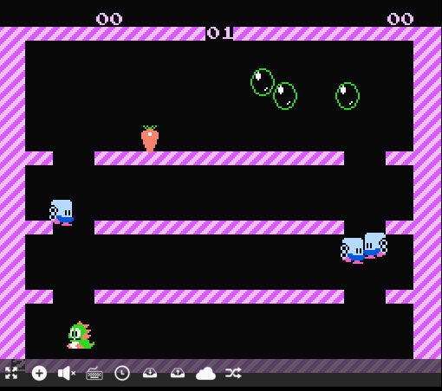
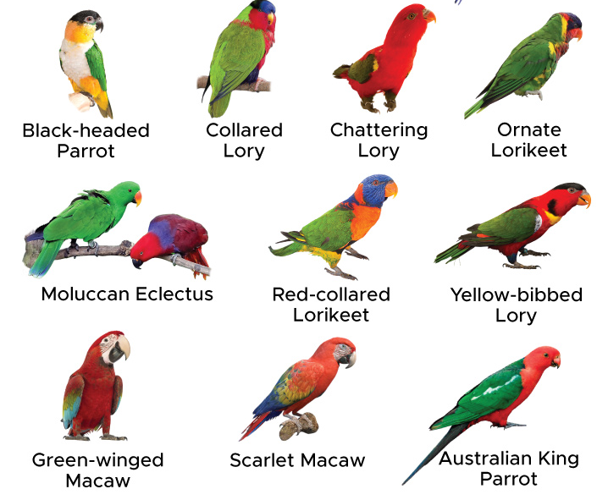
Week11c
Final Project
WARMUP: What part of this game would you implement... first? last?

Slide 157
final project

Slide 158
final project

Slide 159
You may do your final project on whatever you like, provided you can answer the following questions.
What is the title of my project?
What data structures will I use? Note: Arrays count.
What is the game/app that I am proposing? What does it do? How does it feel?
Will the viewer/player interact with my project? How so?
Does Jim think my project is doable? What is my fallback plan if my project ends up being harder than I expect? What extensions can I do if my project ends up being easier than I expect?
What is the very first thing I will implement? (Drawing "the data" is usually a good first step.)

Slide 160
You may do your final project on whatever you like, provided you can answer the following questions.
What is the title of my project?
What data structures will I use? Note: Arrays count.
What is the game/app that I am proposing? What does it do? How does it feel?
Will the viewer/player interact with my project? How so?
Does Jim think my project is doable? What is my fallback plan if my project ends up being harder than I expect? What extensions can I do if my project ends up being easier than I expect?
What is the very first thing I will implement? (Drawing "the data" is usually a good first step.)

Slide 161
example
Woo!-doku
2D array to represent the board.
A colorful sudoku board, that does a happy dance when you solve it.
Click to select cells. Type numbers on the keyboard to fill in numbers.
Yes! And you can write a sudoku solver or automatic board generation if you have extra time!
Store a board I found on the internet as a 2D array (0's for empty cells) and draw it to the Terminal using print statements (or...just skip straight to Cow)

Slide 162
how are we feeling?

Slide 163
why am i making you make a thing

Slide 164
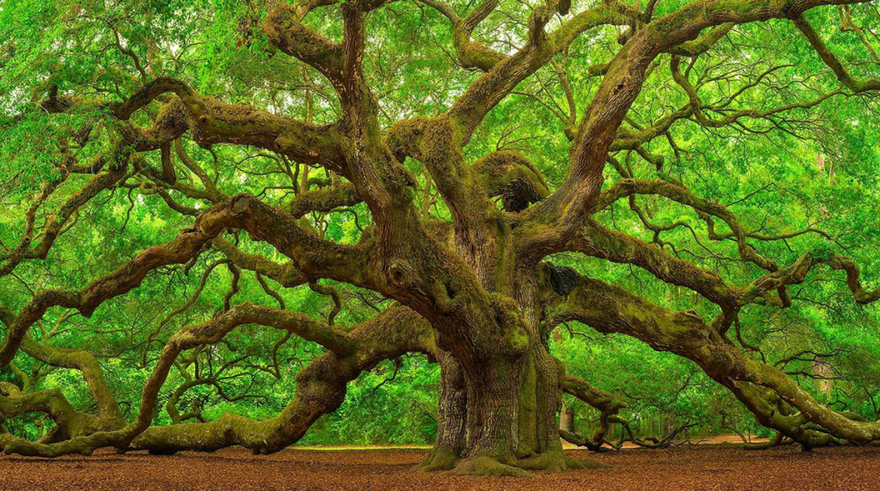

The only way you’re going to grow is by pushing yourself beyond what you think is possible. --David Goggins

Slide 165
how not to make a thing

Slide 166
how not to make a thing

Slide 167
note: this advice is like...just advice feel free to ignore (at your own peril) 🙂

Slide 168
project selection

Slide 169

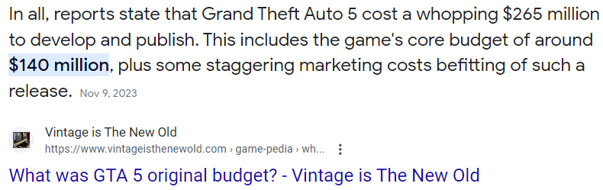
⚠ picking something really, really hard

Slide 170
⚠ picking something with a spooky progress curve
does it work?
deadline
time

Slide 171
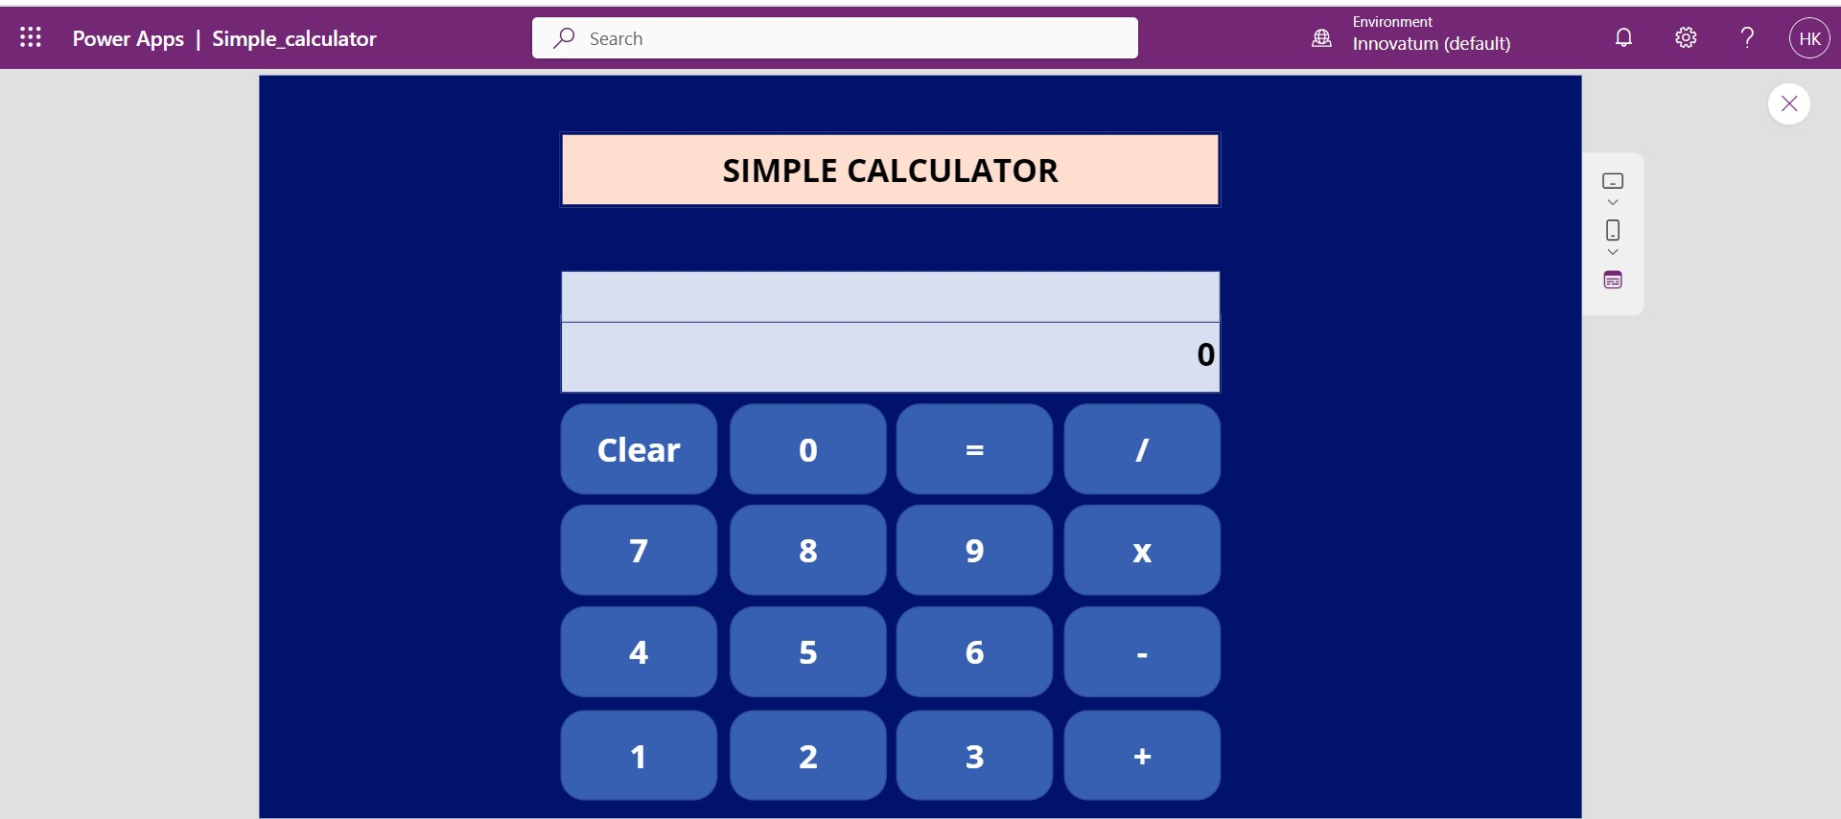
⚠ picking something you aren't really interested in (or can't really be extended)
note: though if you love calculators, go for it!

Slide 172
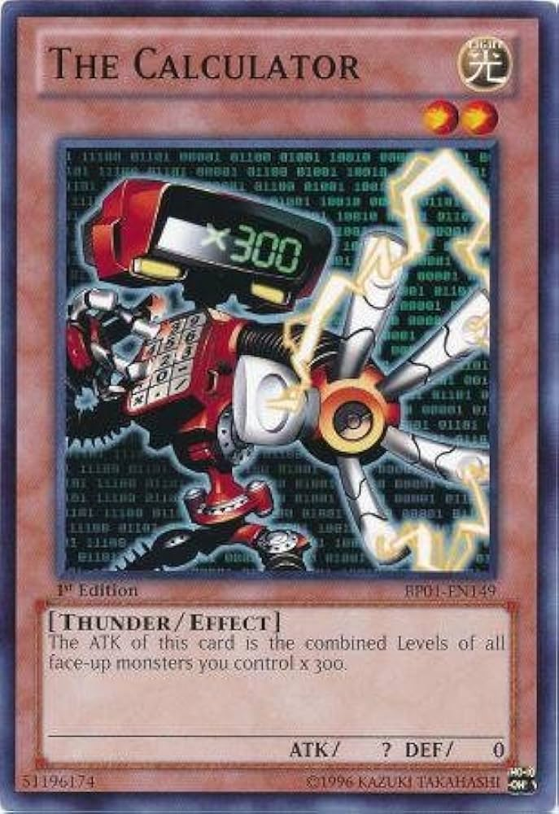

Slide 174
who (doesn't) have a final project idea? discuss amongst each other

Slide 175
focus (just make sudoku)

Slide 176
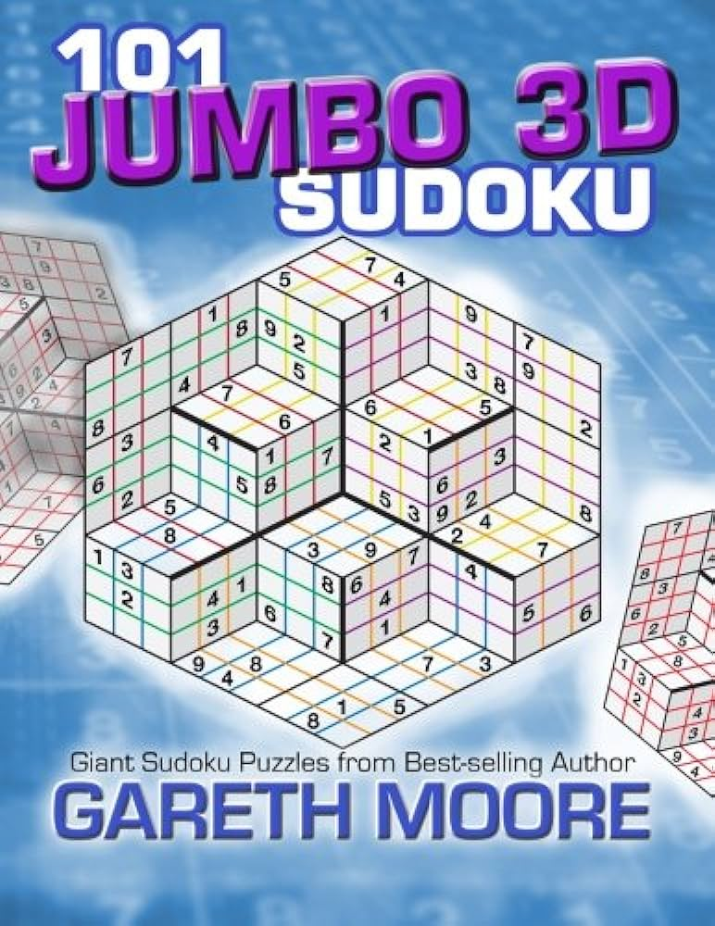
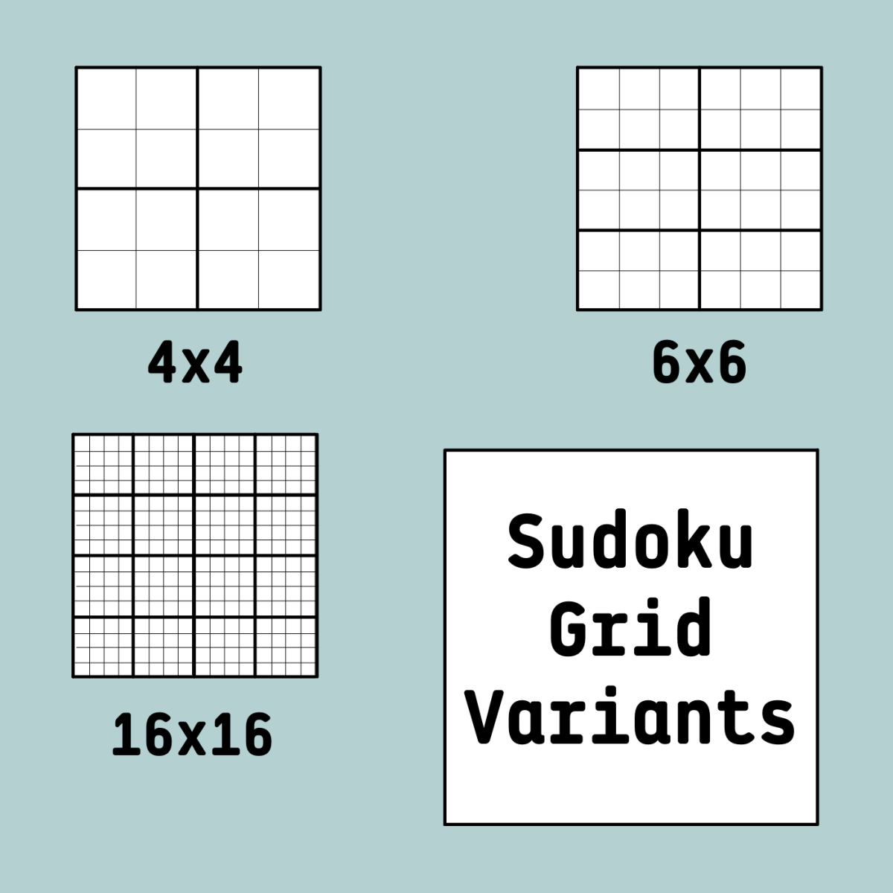
⚠ solving a more general problem than you need to
don't support arbitrary board sizes!
just make sudoku!
what?!

Slide 177
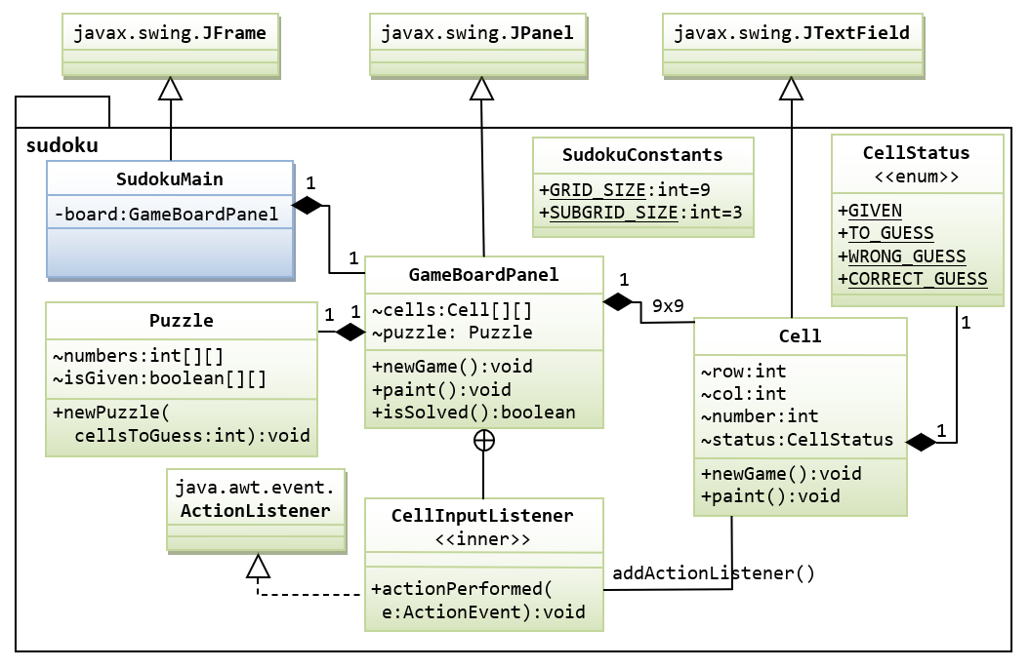
⚠ writing more general code than you need to
don't support multiple different kinds of puzzles
just make sudoku!

Slide 178

⚠ doing the fun part first
don't make a fun animated menu screen
just make sudoku!

Slide 179
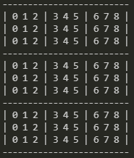
⚠ skipping development steps
consider making a board print to the terminal
before trying to get it working in Cow.java
consider just filling it with nonsense before filling it with a real board
consider hardcoding a starting board by hand
before implementing automatic board generation

Slide 180

then again, sometimes you just gotta go for it.

Slide 181
who (doesn't) know what they're going to implement first? discuss amongst each other

Slide 182
final thoughts

Slide 183
final thoughts
don't be afraid to write code
don't be afraid to delete code
don't be (too) afraid to fail
you will be graded primarily on effort

Slide 184
how are we feeling?

Slide 185
WARMUP
what is (0.1 + 0.1 + 0.1) ?
imagine you wanted to make this thing →
what would you implement 1st? 2nd?
what would you implement LAST? TODAY
who's to say
Bubble Bobble (NES)

Slide 186
Week10a
✨No Laptop Monday! ✨
binary search
binary search trees
WARMUP
how long does it take to find (search for) something in...
- an array list?
- a linked list?
what if the list is sorted?

Slide 187
[record lecture]

Slide 188
review: sorted

Slide 189
sorted

Slide 190
sorted
a sequence is sorted if its elements are "in order"
by convention, this means ascending order (going up from left to right)
[1, 2, 5, 6, 9, 13] is sorted
[9, 5, 1, 2, 6, 13] is unsorted (NOT sored)

Slide 191
search

Slide 192
search
to search means to look for something (in some data structure)
a simple search problem is finding a given value in an array / list
// get index of the first element in array with this value // returns -1 if value not found int find(int[] array, int value) { ... }
// Option B class FindResult { boolean success; int index; } FindResult find(int[] array, int value) { ... }

Slide 193
linear search (of an array / array list)

Slide 194
linear search (brute force search)
linear search looks at each element one by one
linear search works whether or not the list is sorted
linear search is O(n) (linear time) 😐
// get index of the first element in array with this value // returns -1 if value not found int linearSearch(int[] array, int value) { for (int i = 0; i < array.length; ++i) { if (array[i] == value) { return i; } } return -1; }

Slide 195
example: linear search for 17 [13 2 55 7 17 100 77]

Slide 196
example: linear search for 17 [13 2 55 7 17 100 77]

Slide 197
example: linear search for 17 [13 2 55 7 17 100 77]

Slide 198
example: linear search for 17 [13 2 55 7 17 100 77]

Slide 199
example: linear search for 17 [13 2 55 7 17 100 77]

Slide 200
example: linear search for 17 [13 2 55 7 17 100 77]

Slide 201
example: linear search for 17 [13 2 55 7 17 100 77]

Slide 202
example: linear search for 17 [13 2 55 7 17 100 77]

Slide 203
example: linear search for 17 [13 2 55 7 17 100 77]

Slide 204
example: linear search for 17 [13 2 55 7 17 100 77]

Slide 205
example: linear search for 17 [13 2 55 7 17 100 77]

Slide 207
example: linear search for 17 [1 2 4 5 6 8 9 10 11 13 15 16 17 18 19]

Slide 208
example: linear search for 17 [1 2 4 5 6 8 9 10 11 13 15 16 17 18 19]

Slide 209
example: linear search for 17 [1 2 4 5 6 8 9 10 11 13 15 16 17 18 19]

Slide 210
example: linear search for 17 [1 2 4 5 6 8 9 10 11 13 15 16 17 18 19]

Slide 211
example: linear search for 17 [1 2 4 5 6 8 9 10 11 13 15 16 17 18 19]

Slide 212
example: linear search for 17 [1 2 4 5 6 8 9 10 11 13 15 16 17 18 19]

Slide 213
example: linear search for 17 [1 2 4 5 6 8 9 10 11 13 15 16 17 18 19]

Slide 214
example: linear search for 17 [1 2 4 5 6 8 9 10 11 13 15 16 17 18 19]

Slide 215
example: linear search for 17 [1 2 4 5 6 8 9 10 11 13 15 16 17 18 19]

Slide 216
example: linear search for 17 [1 2 4 5 6 8 9 10 11 13 15 16 17 18 19]

Slide 217
example: linear search for 17 [1 2 4 5 6 8 9 10 11 13 15 16 17 18 19]

Slide 218
example: linear search for 17 [1 2 4 5 6 8 9 10 11 13 15 16 17 18 19]

Slide 219
example: linear search for 17 [1 2 4 5 6 8 9 10 11 13 15 16 17 18 19]

Slide 220
example: linear search for 17 [1 2 4 5 6 8 9 10 11 13 15 16 17 18 19]

Slide 221
example: linear search for 17 [1 2 4 5 6 8 9 10 11 13 15 16 17 18 19]

Slide 222
example: linear search for 17 [1 2 4 5 6 8 9 10 11 13 15 16 17 18 19]

Slide 223
example: linear search for 17 [1 2 4 5 6 8 9 10 11 13 15 16 17 18 19]

Slide 224
example: linear search for 17 [1 2 4 5 6 8 9 10 11 13 15 16 17 18 19]

Slide 225
example: linear search for 17 [1 2 4 5 6 8 9 10 11 13 15 16 17 18 19]

Slide 226
example: linear search for 17 [1 2 4 5 6 8 9 10 11 13 15 16 17 18 19]

Slide 227
example: linear search for 17 [1 2 4 5 6 8 9 10 11 13 15 16 17 18 19]

Slide 228
example: linear search for 17 [1 2 4 5 6 8 9 10 11 13 15 16 17 18 19]

Slide 229
example: linear search for 17 [1 2 4 5 6 8 9 10 11 13 15 16 17 18 19]

Slide 230
example: linear search for 17 [1 2 4 5 6 8 9 10 11 13 15 16 17 18 19]

Slide 231
example: linear search for 17 [1 2 4 5 6 8 9 10 11 13 15 16 17 18 19]

Slide 232
example: linear search for 17 [1 2 4 5 6 8 9 10 11 13 15 16 17 18 19]

Slide 233
example: linear search for 17 [1 2 4 5 6 8 9 10 11 13 15 16 17 18 19]

Slide 234
if we know that an array is sorted... can we search it faster?

Slide 235
yes 🚀

Slide 236
unless it's a linked list 💀

Slide 237
binary search (of a array / array list)

Slide 238
binary search
binary search is an O(log n) algorithm for searching a sorted array 🙂
binary search works by "cutting the array in half" over and over
☠️ binary search only applies if the array is sorted

Slide 239
example: binary search for 17 [1 2 4 5 6 8 9 10 11 13 15 16 17 18 19]

Slide 240
example: binary search for 17 [1 2 4 5 6 8 9 10 11 13 15 16 17 18 19]
10 < 17

Slide 241
example: binary search for 17 [1 2 4 5 6 8 9 10 11 13 15 16 17 18 19]

Slide 242
example: binary search for 17 [1 2 4 5 6 8 9 10 11 13 15 16 17 18 19]
16 < 17

Slide 243
example: binary search for 17 [1 2 4 5 6 8 9 10 11 13 15 16 17 18 19]

Slide 244
example: binary search for 17 [1 2 4 5 6 8 9 10 11 13 15 16 17 18 19]
17 < 18

Slide 245
example: binary search for 17 [1 2 4 5 6 8 9 10 11 13 15 16 17 18 19]

Slide 246
example: binary search for 17 [1 2 4 5 6 8 9 10 11 13 15 16 17 18 19]
17 == 17

Slide 247
example: binary search for 17 [1 2 4 5 6 8 9 10 11 13 15 16 17 18 19]

Slide 248
☠️ implementating binary search is surprisingly tricky! make sure you test thoroughly!

Slide 249
✨ hint: binary search [1 2 4 5 6 8 9 10 11 13 15 16 17 18 19]
[^ 2 4 5 6 8 9 10 11 13 15 16 17 18 ^ ]
[| 2 4 5 6 8 9 10 11 13 15 16 17 18 | ]
[i = 0 4 5 6 8 9 10 11 13 15 16 17 18 j ]

Slide 250
review: binary tree

Slide 251
binary tree

Slide 252
binary tree
a binary tree is a tree in which each node has <= 2 children
10
5
16
2
13
18
1
4
11
15
17

Slide 253
🧠 can a linked list be seen as a binary tree?

Slide 254
technically, yes (assuming no cycles) all nodes have <= 2 children (tail has 0 children, all other nodes have 1 child)

Slide 255
ordered binary tree

Slide 256
(ordered) binary tree
each node has a left child and a right child (either or both children can be null)
10
5
16
node
13
18
11
15
17
node.leftChild
node.rightChild

Slide 257
(ordered) binary tree
each node has a left subtree and a right subtree (and left descendants and right descendants)

Slide 258
binary search tree

Slide 259
binary search tree

Slide 260
binary search tree
in a binary search tree (BST, sorted binary tree) every node follows: "a node's value is greater than the values of all nodes in its left subtree and less than the values of all nodes in its right subtree"
10
5
16
2
13
18
1
4
11
15
17

Slide 261
binary search tree
in a binary search tree (BST, sorted binary tree) every node follows: "a node's value is greater than the values of all nodes in its left subtree and less than the values of all nodes in its right subtree"
10
10 < 16
5
16
5 < 10
2 < 10
10 < 13
2
13
18
10 < 18
1
4
10 < 11
11
15
17
10 < 17
4 < 10
1 < 10
10 < 15

Slide 262
binary search tree
in a binary search tree (BST, sorted binary tree) every node follows: "a node's value is greater than the values of all nodes in its left subtree and less than the values of all nodes in its right subtree"
10
5
16
13 < 16
2
13
18
16 < 18
1
4
11 < 16
11
15
17
16 < 17
15 < 16

Slide 263
binary search tree
in a binary search tree (BST, sorted binary tree) every node follows: "a node's value is greater than the values of all nodes in its left subtree and less than the values of all nodes in its right subtree"
10
5
16
2
13
18
1
4
11
15
17

Slide 264
is it a BST?

Slide 265
2
4
1
3
6
Is It A Binary Search Tree?
4
9
3
5
in a binary search tree (sorted binary tree) every node follows: "a node's value is greater than the values of all nodes in its left subtree and less than the values of all nodes in its right subtree"
2
1
10
5
16
2
8
13
18
1
4
6
9
14
15
17
19

Slide 266
2
4
1
3
6
4
9
3
5
in a binary search tree (sorted binary tree) every node follows: "a node's value is greater than the values of all nodes in its left subtree and less than the values of all nodes in its right subtree"
2
1
10
5
16
2
8
13
18
1
4
6
9
14
15
17
19

Slide 267
binary search (of a binary search tree)

Slide 268
binary search
binary search "cuts a BST in half" over and over
binary search only works when the binary tree is sorted (is a binary search tree)
binary search is O(log n) if the tree is "balanced" 🙂
balanced means each node's children are similar in height (intuitive understanding of this is sufficient; will discuss more on Fri)
10
10
5
16
5
2
8
13
18
2
1
6
9
11
9
1
balanced
NOT balanced

Slide 269
example: binary search for 17 [1 2 4 5 6 8 9 10 11 13 15 16 17 18 19]
10
5
16
2
8
13
18
1
4
6
9
11
15
17
19

Slide 270
example: binary search for 17 [1 2 4 5 6 8 9 10 11 13 15 16 17 18 19]
10
10 < 17
5
16
2
8
13
18
1
4
6
9
11
15
17
19

Slide 271
example: binary search for 17 [1 2 4 5 6 8 9 10 11 13 15 16 17 18 19]
10
5
16
2
8
13
18
1
4
6
9
11
15
17
19

Slide 272
example: binary search for 17 [1 2 4 5 6 8 9 10 11 13 15 16 17 18 19]
10
5
16
16 < 17
2
8
13
18
1
4
6
9
11
15
17
19

Slide 273
example: binary search for 17 [1 2 4 5 6 8 9 10 11 13 15 16 17 18 19]
10
5
16
2
8
13
18
1
4
6
9
11
15
17
19

Slide 274
example: binary search for 17 [1 2 4 5 6 8 9 10 11 13 15 16 17 18 19]
10
5
16
2
8
13
18
17 < 18
1
4
6
9
11
15
17
19

Slide 275
example: binary search for 17 [1 2 4 5 6 8 9 10 11 13 15 16 17 18 19]
10
5
16
2
8
13
18
1
4
6
9
11
15
17
19

Slide 276
example: binary search for 17 [1 2 4 5 6 8 9 10 11 13 15 16 17 18 19]
10
5
16
2
8
13
18
1
4
6
9
11
15
17
19
17 == 17

Slide 277
example: binary search for 17 [1 2 4 5 6 8 9 10 11 13 15 16 17 18 19]
10
5
16
2
8
13
18
1
4
6
9
11
15
17
19

Slide 278
note: a binary search tree is NOT unique let's look at another BST for the same data!

Slide 279
example: binary search for 17 [1 2 4 5 6 8 9 10 11 13 15 16 17 18 19]
2
1
4
5
6
8
9
10
11
13
15
16
17
18
19

Slide 280
example: binary search for 17 [1 2 4 5 6 8 9 10 11 13 15 16 17 18 19]
2
1
4
5
6
8
9
10
11
13
15
16
17
18
19

Slide 281
example: binary search for 17 [1 2 4 5 6 8 9 10 11 13 15 16 17 18 19]
2
1
4
5
6
8
9
10
11
13
15
16
17
18
19

Slide 282
example: binary search for 17 [1 2 4 5 6 8 9 10 11 13 15 16 17 18 19]
2
1
4
5
6
8
9
10
11
13
15
16
17
18
19

Slide 283
example: binary search for 17 [1 2 4 5 6 8 9 10 11 13 15 16 17 18 19]
2
1
4
5
6
8
9
10
11
13
15
16
17
18
19

Slide 284
example: binary search for 17 [1 2 4 5 6 8 9 10 11 13 15 16 17 18 19]
2
1
4
5
6
8
9
10
11
13
15
16
17
18
19

Slide 285
example: binary search for 17 [1 2 4 5 6 8 9 10 11 13 15 16 17 18 19]
2
1
4
5
6
8
9
10
11
13
15
16
17
18
19

Slide 286
example: binary search for 17 [1 2 4 5 6 8 9 10 11 13 15 16 17 18 19]
2
1
4
5
6
8
9
10
11
13
15
16
17
18
19

Slide 287
example: binary search for 17 [1 2 4 5 6 8 9 10 11 13 15 16 17 18 19]
2
1
4
5
6
8
9
10
11
13
15
16
17
18
19

Slide 288
...

Slide 289
life lesson: it is important that your binary search tree is ✨balanced✨ (otherwise your "binary search" degrades into linear search of a linked list ☹️)

Slide 290
adding a new node to a binary search tree (the naive (simple but bad) method)

Slide 291
for a binary search tree, add starts out just like search

Slide 292
just keep going until you hit a null node put the new node there 🙂👍

Slide 293
example: adding 7
10
5
16
2
8
13
18
1
4
6
9
11
15
17
19

Slide 294
example: adding 7
10
5
16
2
8
13
18
1
4
6
9
11
15
17
19

Slide 295
example: adding 7
10
5
16
2
8
13
18
1
4
6
9
11
15
17
19

Slide 296
example: adding 7
10
5
16
2
8
13
18
1
4
6
9
11
15
17
19

Slide 297
example: adding 7
10
5
16
2
8
13
18
1
4
6
9
11
15
17
19

Slide 298
example: adding 7
10
5
16
2
8
13
18
1
4
6
9
11
15
17
19
null

Slide 299
example: adding 7
10
5
16
2
8
13
18
1
4
6
9
11
15
17
19
7

Slide 300
example: adding 7
10
5
16
2
8
13
18
1
4
6
9
11
15
17
19
7

Slide 301
is this approach to adding a new node good? hint: no.

Slide 302
self-balancing binary search trees note: hard to implement

Slide 303


Slide 304
uses of binary search trees

Slide 305
tree map (implement a map)
you can implement the map interface using a BST NOTE: this is NOT a hash map!—no hashing is involved!
class Node {
String key; // NOTE: BST is sorted by key
Integer value;
Node leftChild;
Node rightChild;
}
class TreeMap { Node root;
ValueType get(KeyType) { ... }
void put(ValueType, KeyType) { ... }
}
"Ditto"
132
"Arbok"
24
"Mew"
151

Slide 306
Week10b
✨Wednesday! ✨
WARMUP
what does "sink or swim" mean?
BST traversal order review
heaps, heapsort
ANNOUNCEMENTS
Jim out of town Wed-Fri (TA's will run lab)
Tacos Tacos Tacos tomorrow at 7 pm

Slide 307
review: binary tree depth-first traversal orders

Slide 308
binary tree depth-first traversal orders

Slide 309
depth-first traversal orders (of a binary tree)
pre-order = self, left, right
3, 1, 0, 2, 5, 4, 6
in-order = left, self, right
0, 1, 2, 3, 4, 5, 6
post-order = left, right, self
0, 2, 1, 4, 6, 5, 3
reverse pre-order = self, right, left
3, 5, 6, 4, 1, 2, 0
reverse in-order = right, self, left
6, 5, 4, 3, 2, 1, 0
reverse post-order = right, left, self
6, 4, 5, 2, 0, 1, 3
3
1
5
0
2
4
6

Slide 310
2 * 3
+ 4
who's that
traversal order?
+
in-order!
*
4
2
3

Slide 311
the most satisfying function in CS 136
void recurse(Node self) {
// NOTE: rearranging these 3 lines gives you all
// 3! ("three factorial") = 6 traversal orders
if (self.leftChild != null) { recurse(self.leftChild); }
System.out.print(self.value + " ");
if (self.rightChild != null) { recurse(self.rightChild); }
}

Slide 312
[Live-code traversal orders] (Feel free to follow along or race.)

Slide 313
heaps

Slide 314
always-complete max binary heap

Slide 315
always-complete max binary heap
in this class, when we say "heap" or "max heap", we mean an "always-complete max binary heap"
we might occasionally mention a "min heap", which means an "always-complete min binary heap"

Slide 316
always-complete max binary heap
in a complete binary tree, all levels (depths, rows) are "full of nodes", except for possibly the bottom level, in which all nodes are "as far to to the left as possible"
10
10
5
16
5
16
2
8
13
18
2
8
13
18
1
4
6
9
11
1
4
6
11
complete
(and balanced)
balanced but NOT complete

Slide 317
always-complete max binary heap
in a complete binary tree, all levels (depths) are "full of nodes", except for possibly the bottom level, in which all nodes are "as far to to the left as possible"
10
5
16
2
8
13
18
1
4
6
9
the "last node"
complete
(and balanced)

Slide 318
always-complete max binary heap
"always-complete" means that every function in the Heap interface (add(...) & remove()) "preserves the completeness of the heap"
the heap was complete before calling add...
...and the heap is still complete after add returns
the heap is always complete
always complete.

Slide 319
always-complete max binary heap
a binary heap is another special kind of binary tree
☠️ a binary heap is NOT, in general, a binary search tree

Slide 320
always-complete max binary heap
in a max binary heap, every node follows: "a node's value is greater than the value of its left child and the value of its right child"
27
15
5
7
13
4
2
6
3
11
12
1

Slide 321
always-complete max binary heap
in a max binary heap, every node follows: "a node's value is greater than the value of its left child and the value of its right child"
27
27 > 15
27 > 5
15
5
7
13
4
2
6
3
11
12
1

Slide 322
always-complete max binary heap
in a max binary heap, every node follows: "a node's value is greater than the value of its left child and the value of its right child"
27
15
5
7
13
4
2
6
3
11
12
1
7 > 6
7 > 3

Slide 323
always-complete max binary heap
in a max binary heap, every node follows: "a node's value is greater than the value of its left child and the value of its right child"
🧠 is the "max heap property" above equivalent to...
in a max binary heap, every node follows: "a node's value is greater than the values of all its descendants"
yes.
idea: apply definition recursively
node's value is greater than the values of its children... ...which are greater than the values of their children...
🧠 which node always has the max value of all nodes in the heap?
the root

Slide 324
always-complete max binary heap
in a max binary heap, every node follows: "a node's value is greater than the values of all its descendants"
27
15
5
15 > 7
7
15 > 13
13
4
2
6
3
11
12
1
15 > 6
15 > 3
15 > 11
15 > 12

Slide 325
heap interface add(...) & remove() 🐡 ⚓️ a heap is like a benthic trawl net (ish)

Slide 326
heap interface
// Add this value to the heap. void add(ValueType value) { ... }
// Remove the max value from the heap, and return it. ValueType remove() { ... }

Slide 327
add(...)

Slide 328
void add(ValueType value);
to add a new node with a given value to a max binary heap...
add the new node so that the heap is still complete (add into "the next empty slot")
while that node violates the max heap property...
swap it with its parent
the node "swims up" 🐡
"sifts up"
"heap up"?

Slide 329
example: adding 10
27
15
5
7
13
4
2
6
3
11
12
1

Slide 330
example: adding 10
27
15
5
7
13
4
2
6
3
11
12
1

Slide 331
example: adding 10
27
15
5
7
13
4
2
6
3
11
12
1
10

Slide 332
example: adding 10
27
15
5
7
13
4
2
6
3
11
12
1
10

Slide 333
example: adding 10
27
15
5
7
13
4
2
6
3
11
12
1
10

Slide 334
example: adding 10
27
15
5
7
13
10
2
6
3
11
12
1
4

Slide 335
example: adding 10
27
15
5
7
13
10
2
6
3
11
12
1
4

Slide 336
example: adding 10
27
15
5
7
13
10
2
6
3
11
12
1
4

Slide 337
example: adding 10
27
15
5
7
13
10
2
6
3
11
12
1
4

Slide 338
example: adding 10
27
15
10
7
13
5
2
6
3
11
12
1
4

Slide 339
example: adding 10
27
15
10
7
13
5
2
6
3
11
12
1
4

Slide 340
example: adding 10
27
15
10
7
13
5
2
6
3
11
12
1
4

Slide 341
example: adding 10
27
15
10
7
13
5
2
6
3
11
12
1
4

Slide 342
example: adding 10
27
15
10
7
13
5
2
6
3
11
12
1
4

Slide 343
remove()

Slide 344
ValueType remove();
to remove the node with max value (the root) from a max binary heap...
save the root's value in a temporary variable called result
replace the root with the last node (rightmost node in the bottom level) (the old root is now "garbage" and ready to be garbage collected 🚛)
while that node violates the max heap property...
swap it with its larger child
return result;
the node "sinks down" ⚓️
"sifts down"
"heap down"?

Slide 345
example: removing max node
27
15
5
7
13
4
2
6
3
11
0
1

Slide 346
example: removing max node
int result = root.value;
27
15
5
7
13
4
2
6
3
11
0
1

Slide 347
example: removing max node
27
15
5
7
13
4
2
6
3
11
0
1

Slide 348
example: removing max node
27
15
5
7
13
4
2
6
3
11
0
1

Slide 349
example: removing max node
1
15
5
7
13
4
2
6
3
11
0

Slide 350
example: removing max node
1
15
5
7
13
4
2
6
3
11
0

Slide 351
example: removing max node
1
15
5
7
13
4
2
6
3
11
0

Slide 352
example: removing max node
1
15
5
7
13
4
2
6
3
11
0

Slide 353
example: removing max node
15
1
5
7
13
4
2
6
3
11
0

Slide 354
example: removing max node
15
1
5
7
13
4
2
6
3
11
0

Slide 355
example: removing max node
15
1
5
7
13
4
2
6
3
11
0

Slide 356
example: removing max node
15
1
5
7
13
4
2
6
3
11
0

Slide 357
example: removing max node
15
1
5
7
13
4
2
6
3
11
0

Slide 358
example: removing max node
15
13
5
7
1
4
2
6
3
11
0

Slide 359
example: removing max node
15
13
5
7
1
4
2
6
3
11
0

Slide 360
example: removing max node
15
13
5
7
1
4
2
6
3
11
0

Slide 361
example: removing max node
15
13
5
7
1
4
2
6
3
11
0

Slide 362
example: removing max node
15
13
5
7
11
4
2
6
3
1
0

Slide 363
example: removing max node
15
13
5
7
11
4
2
6
3
1
0

Slide 364
example: removing max node
15
13
5
7
11
4
2
6
3
1
0

Slide 365
example: removing max node
15
13
5
7
11
4
2
6
3
1
0

Slide 366
example: removing max node
15
13
5
7
11
4
2
6
3
1
0
return result;

Slide 367
(implicit) heapsort

Slide 368

because a heap is an always-complete binary tree, we can store a heap "implicitly" as an array using a breadth-first (level-order) traversal!
[ 9 8 7 6 4 1 2 3 5 ]
9
8
7
6
4
1
2
3
5

Slide 369
this lets us do (in-place) implicit heapsort! (using only swaps)

Slide 370
1. build a heap by calling add(...) over and over 2. deconstruct the heap by calling remove() over and over

Slide 371
[ 7 3 2 4 6 1 8 5 9 ]

Slide 372
[ 7 3 2 4 6 1 8 5 9 ]
7

Slide 373
[ 7 3 2 4 6 1 8 5 9 ]
7
3

Slide 374
[ 7 3 2 4 6 1 8 5 9 ]
7
3
2

Slide 375
[ 7 3 2 4 6 1 8 5 9 ]
7
3
2
🐡
4

Slide 376
[ 7 4 2 3 6 1 8 5 9 ]
7
💦
4
2
3

Slide 377
[ 7 4 2 3 6 1 8 5 9 ]
7
4
2
3

Slide 378
[ 7 4 2 3 6 1 8 5 9 ]
7
4
2
🐡
3
6

Slide 379
[ 7 6 2 3 4 1 8 5 9 ]
7
6
💦
2
3
4

Slide 380
[ 7 6 2 3 4 1 8 5 9 ]
7
6
2
3
4

Slide 381
[ 7 6 2 3 4 1 8 5 9 ]
7
6
2
3
4
1

Slide 382
[ 7 6 2 3 4 1 8 5 9 ]
7
6
2
🐡
3
4
1
8

Slide 383
[ 7 6 8 3 4 1 2 5 9 ]
7
🐡
6
8
3
4
1
2

Slide 384
[ 8 6 7 3 4 1 2 5 9 ]
8
💦
6
7
3
4
1
2

Slide 385
[ 8 6 7 3 4 1 2 5 9 ]
8
6
7
3
4
1
2

Slide 386
[ 8 6 7 3 4 1 2 5 9 ]
8
6
7
3
4
1
2
🐡
5

Slide 387
[ 8 6 7 5 4 1 2 3 9 ]
8
6
7
💦
5
4
1
2
3

Slide 388
[ 8 6 7 5 4 1 2 3 9 ]
8
6
7
5
4
1
2
3

Slide 389
[ 8 6 7 5 4 1 2 3 9 ]
8
6
7
5
4
1
2
🐡
3
9

Slide 390
[ 8 6 7 9 4 1 2 3 5 ]
8
6
7
🐡
9
4
1
2
3
5

Slide 391
[ 8 9 7 6 4 1 2 3 5 ]
8
🐡
9
7
6
4
1
2
3
5

Slide 392
[ 9 8 7 6 4 1 2 3 5 ]
💦
9
8
7
6
4
1
2
3
5

Slide 393
[ 9 8 7 6 4 1 2 3 5 ]
9
8
7
6
4
1
2
3
5

Slide 394
[ 9 8 7 6 4 1 2 3 5 ]
9
8
7
6
4
1
2
3
5

Slide 395
[ 5 8 7 6 4 1 2 3 9 ]
⚓️
5
8
7
6
4
1
2
3

Slide 396
[ 8 5 7 6 4 1 2 3 9 ]
8
⚓️
5
7
6
4
1
2
3

Slide 397
[ 8 6 7 5 4 1 2 3 9 ]
8
6
7
💦
5
4
1
2
3

Slide 398
[ 8 6 7 5 4 1 2 3 9 ]
8
6
7
5
4
1
2
3

Slide 399
[ 8 6 7 5 4 1 2 3 9 ]
8
6
7
5
4
1
2
3

Slide 400
[ 3 6 7 5 4 1 2 8 9 ]
3
⚓️
6
7
5
4
1
2

Slide 401
[ 7 6 3 5 4 1 2 8 9 ]
7
💦
6
3
5
4
1
2

Slide 402
[ 7 6 3 5 4 1 2 8 9 ]
7
6
3
5
4
1
2

Slide 403
[ 7 6 3 5 4 1 2 8 9 ]
7
6
3
5
4
1
2

Slide 404
[ 2 6 3 5 4 1 7 8 9 ]
⚓️
2
6
3
5
4
1

Slide 405
[ 6 2 3 5 4 1 7 8 9 ]
6
⚓️
2
3
5
4
1

Slide 406
[ 6 5 3 2 4 1 7 8 9 ]
6
5
3
💦
2
4
1

Slide 407
[ 6 5 3 2 4 1 7 8 9 ]
6
5
3
2
4
1

Slide 408
[ 6 5 3 2 4 1 7 8 9 ]
6
5
3
2
4
1

Slide 409
[ 1 5 3 2 4 6 7 8 9 ]
⚓️
1
5
3
2
4

Slide 410
[ 5 1 3 2 4 6 7 8 9 ]
5
1
⚓️
3
2
4

Slide 411
[ 5 4 3 2 1 6 7 8 9 ]
5
4
3
💦
2
1

Slide 412
[ 5 4 3 2 1 6 7 8 9 ]
5
4
3
2
1

Slide 413
[ 5 4 3 2 1 6 7 8 9 ]
5
4
3
2
1

Slide 414
[ 1 4 3 2 5 6 7 8 9 ]
⚓️
1
4
3
2

Slide 415
[ 4 1 3 2 5 6 7 8 9 ]
4
⚓️
1
3
2

Slide 416
[ 4 2 3 1 5 6 7 8 9 ]
4
2
3
💦
1

Slide 417
[ 4 2 3 1 5 6 7 8 9 ]
4
2
3
1

Slide 418
[ 4 2 3 1 5 6 7 8 9 ]
4
2
3
1

Slide 419
[ 1 2 3 4 5 6 7 8 9 ]
1
⚓️
2
3

Slide 420
[ 3 2 1 4 5 6 7 8 9 ]
3
💦
2
1

Slide 421
[ 3 2 1 4 5 6 7 8 9 ]
3
2
1

Slide 422
[ 3 2 1 4 5 6 7 8 9 ]
3
2
1

Slide 423
[ 1 2 3 4 5 6 7 8 9 ]
⚓️
1
2

Slide 424
[ 2 1 3 4 5 6 7 8 9 ]
2
💦
1

Slide 425
[ 2 1 3 4 5 6 7 8 9 ]
2
1

Slide 426
[ 2 1 3 4 5 6 7 8 9 ]
2
1

Slide 427
[ 1 2 3 4 5 6 7 8 9 ]
1

Slide 428
[ 1 2 3 4 5 6 7 8 9 ]
1

Slide 429
[ 1 2 3 4 5 6 7 8 9 ]
1

Slide 430
[ 1 2 3 4 5 6 7 8 9 ]

Slide 431
heap application: priority queue

Slide 432

review: queue
remove();

Slide 433
review: queue
remove();

Slide 434
review: queue
add();

Slide 435
review: queue
add();

Slide 436
review: queue
remove();

Slide 437
review: queue

Slide 438
extension: priority queue

Slide 439

extension: priority queue

Slide 440

extension: priority queue
priority 1

Slide 441

extension: priority queue
priority 1
priority 1

Slide 442

extension: priority queue
priority 9
priority 1
priority 1

Slide 443

extension: priority queue
priority 9
priority 1
priority 1
priority 5

Slide 444

extension: priority queue
priority 999
priority 9
priority 1
priority 1
priority 5

Slide 445
extension: priority queue
priority 999
priority 9
priority 1
priority 1
priority 5

Slide 446
a priority queue's remove() function removes the element with highest priority

Slide 447
a max heap's remove() function removes the node with maximum value

Slide 448
✨ a max heap is a natural way to implement a priority queue ✨

Slide 449
Week09a
✨No Laptop Monday Funday! ✨
🦜🦜🦜
🦜🦜🦜
🦜🦜🦜
directed graph preview
trees
BOTANY WARMUP
what is a tree?
what is a branch?
what is a node?
ADDITIONAL WARMUP
what does binary mean?
what is a binary tree?
what does ternary mean?
[record lecture]

Slide 450
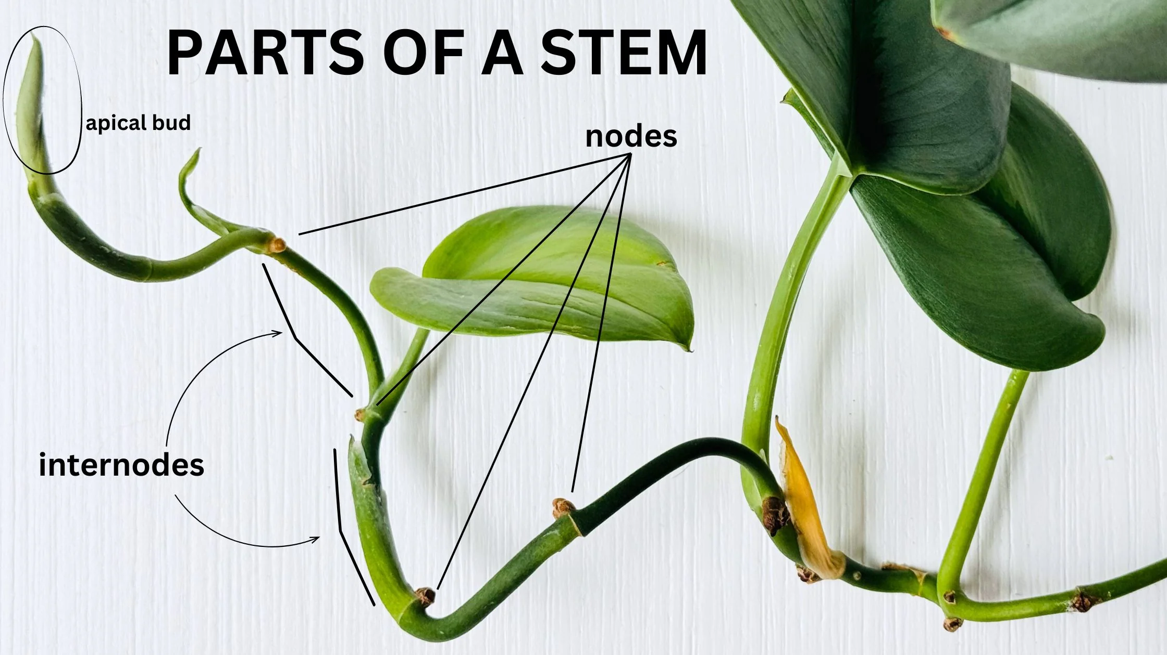

Slide 451
directed graphs

Slide 452
quick note: Math vs. CS

Slide 453
CS vs. Math
a directed graph is a data structure
it has nodes that refer to any number of other nodes
a directed graph G = (V, E) is also a mathematical object
it has vertices (nodes) V
it has directed edges E
note: E is a set of 2-tuples

Slide 454
these are really just two different ways of looking at the same thing

Slide 455
both are useful! (Math to figure out the algorithm, CS to code it up)

Slide 456
in CSCI 136, i will focus on the CS view (MATH 200, CSCI 256 will look at the Math side)

Slide 457
🙂👍

Slide 458
directed graph

Slide 459
the directed graph generalizes the linked list
a node in a directed graph has references to any number of other nodes
nodes are drawn as circles
references are drawn as arrows
let's not worry about
whether this is allowed
or whether this is allowed

Slide 460
(whether we allow for self-edges, multiple edges, etc. depends on context)

Slide 461
🙂👍

Slide 462
tree

Slide 463
kinship terminology (parent, child, etc.)

Slide 464
kinship terminology is useful for describing trees
a node has references to other nodes
it is their parent
they are its children

Slide 465
(directed) tree

Slide 466
a (directed) tree is a directed graph that...
has exactly one node with zero parents (the root)
has no nodes with more than one parent
has no cycles (loops) of any kind
is connected (just one tree, not multiple disconnected trees)
(otherwise, it would be a forest)
5
16
2
2
2
13
18
1
4
11
15
19

Slide 467
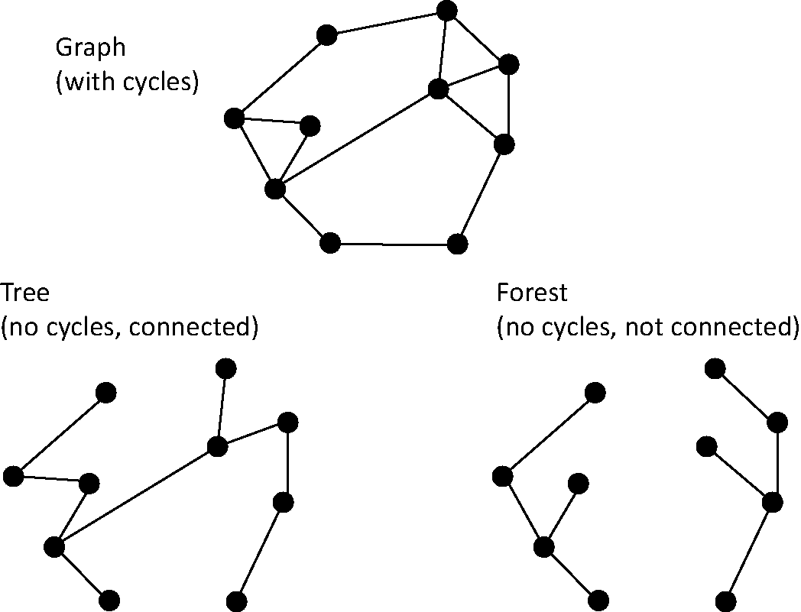
note: not joking

Slide 468
Monday Funday

Slide 469
time for everyone's favorite home game...

Slide 470
is it a tree?
yes
no
violates 2 & 3
tree rules
exactly one node with zero parents
no node with more than one parent
no cycles
is connected
no
violates 2 & 3
no
violates 1 & 4
no
violates 1 & 3
yes

Slide 471
is it a tree?
yes

Slide 472

can be seen as

Slide 473
uses of trees

Slide 474
simplifying expressions

Slide 475
(2 + 3)
* 4
*
+
4
2
3

Slide 476
5
* 4
*
5
4

Slide 477
20
20

Slide 478
!
(true && )
(false || true)
!
&&
true
||
false
true

Slide 479
!
(true && true)
!
&&
true
true

Slide 480
!true
!
true

Slide 481
false
false

Slide 482
and so much more!

Slide 483
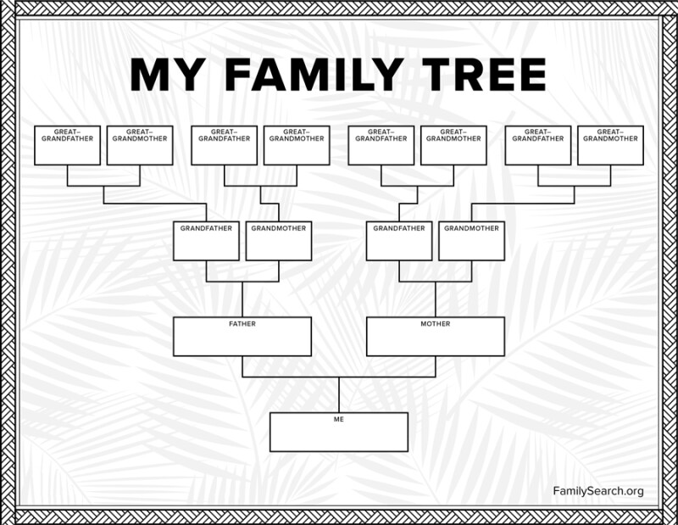

Slide 484
careful: these nodes are
the children of
the node with value jim
jim
jim's mom
jim's dad
jim's mom's mom
jim's mom's dad
jim's dad's mom
jim's dad's dad

Slide 485
note: family trees considered deeply confusing; let us never talk of them again 🙅

Slide 486
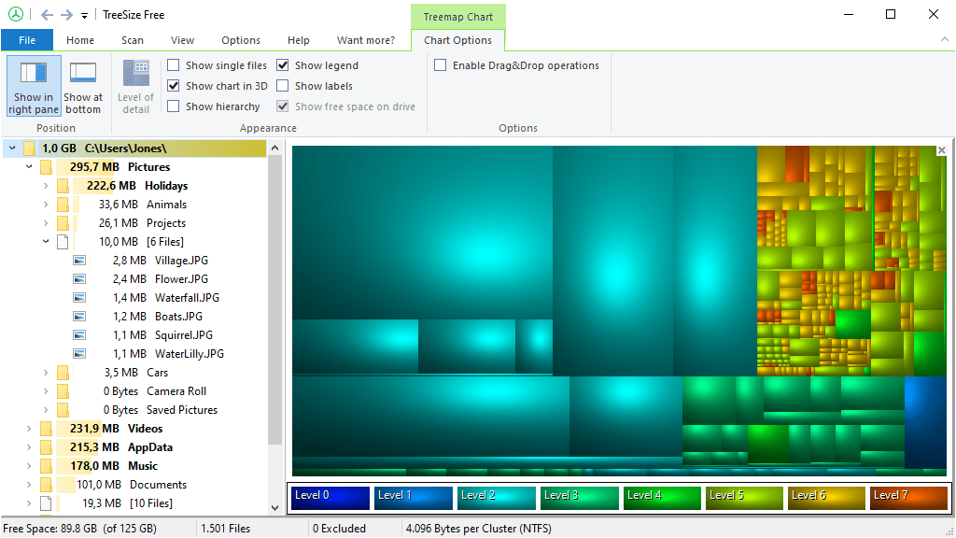
File System (TreeSize Free)
https://www.jam-software.com/treesize_free

Slide 487
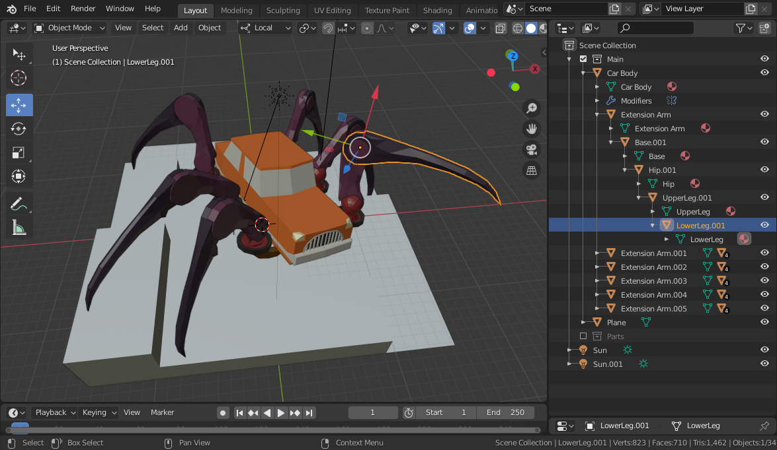
Transformation Hierarchy (Blender)
https://15466.courses.cs.cmu.edu/lesson/hierarchy

Slide 488
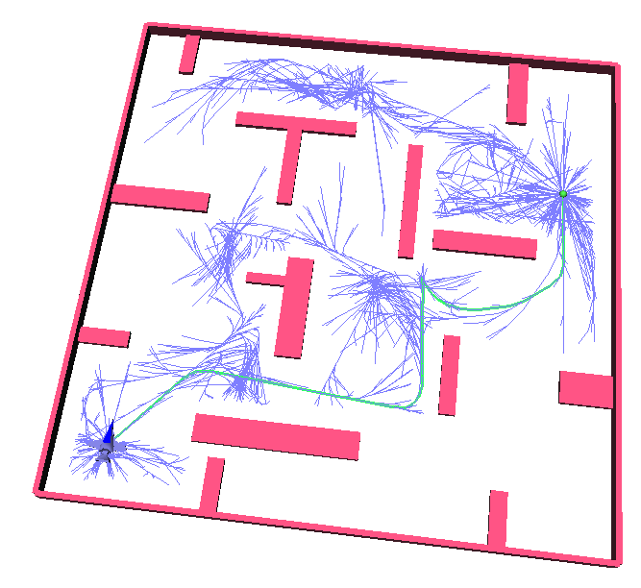
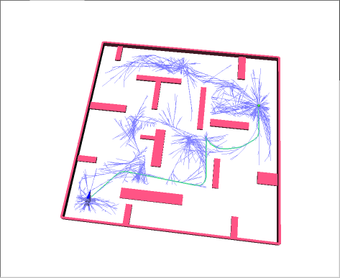
Rapidly Exploring Random Trees (RRTs)
Randomized Kinodynamic Planning by Steven M. LaValle and James J. Kuffner, Jr., International Journal of Robotics Research, 20(5):378--400, May 2001

Slide 489
Hierplane (Mark)

Slide 490
[homework preview]

Slide 491
different ways to implement trees

Slide 492
ArrayList<Node> children; Node leftChild; Node rightChild; Node[] children;

Slide 493
Week09b
✨Laptop Wednesday! ✨
for-each loop
tree terminology
terrific tree traversal tutorial
BONUS WARMUP
evaluate this expression tree
🦜🦜🦜
🦜🦜🦜
🦜🦜🦜
WARMUP
what does depth mean?
what does breadth mean?
what does first mean?

Slide 494
[address the election?]

Slide 495
[record lecture]

Slide 496
☠️ for-each loop

Slide 497
☠️ for-each loop

Slide 498
🐍 Python's for loop is a for-each loop
lst = [ True, 5.0, "Hello" ]
for element in lst: # for each item in the list...
print(element)

Slide 499
a for-each loop can be a convenient alternative to a for loop
for (int turretIndex = 0; turretIndex < turrets.length; ++turretIndex) {
Turret turret = turrets[turretIndex];
...
}
for (Turret turret : turrets) { // for each turret in turrets...
...
}

Slide 500
a for-each loop can be a convenient alternative to a for loop
for (int strokeIndex = 0; strokeIndex < currentFrame.size(); ++strokeIndex) {
ArrayList<Point> stroke = currentFrame.get(strokeIndex);
for (int pointIndex = 0; pointIndex < stroke.size(); ++pointIndex) {
Point point = stroke.get(pointIndex);
...
}
}
for (ArrayList<Point> stroke : currentFrame) {
for (Point point : stroke) {
...
}
}
forgive me 🥲
i swear all that indexing built character

Slide 501
for-each can be convenient but...

Slide 502
you never *need* a for-each loop (some languages don't even have one)

Slide 503
☠️ for-each loops can get you into trouble if you don't fully understand how references and Objects work in Java

Slide 504
☠️ for-each loop dangers
☠ a for-each loop provides a "convenient reference"
☠ LESS powerful than a regular for loop
for (int i = 0; i < things.length; ++i) {
Thing thing = things[i]; // thing is a "convenient reference"
...
}
for (Thing thing : things) { // thing is a "convenient reference"
...
}

Slide 505
☠️ for-each loop dangers
for (int i = 0; i < things.length; ++i) {
things[i] = new Thing(); // does write to array 🙂👍
}
for (int i = 0; i < things.length; ++i) {
Thing thing = things[i]; // thing is a "convenient reference"
thing = new Thing(); // does NOT write to array
}
for (Thing thing : things) { // thing is a "convenient reference"
thing = new Thing(); // does NOT write to array
}

Slide 506
☠️ for-each loop for iterating over a String
in Java, a for-each loop can iterate through String's with toCharArray()
☠ toCharArray() is O(n), but fine for CSCI 136
for (char c : string.toCharArray()) {
...
}

Slide 507
more tree terminology

Slide 508
more tree terminology

Slide 511
the root has no parents a leaf has no children
root
5
16
2
13
18
leaves

Slide 512
a path is a chain of distinct edges
16
path
13
18

Slide 513
a node's depth is the number of edges in the path from the root to that node
depth 0
5
16
depth 1
2
13
18
depth 2
depth 3

Slide 514
level means either depth or (depth + 1) depending on who you ask 🤷‍♀️

Slide 515
tree traversal

Slide 516
breadth-first vs. depth-first

Slide 517


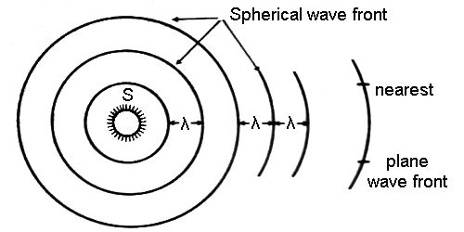
breadth-first vs. (pre-order) depth-first
"a persistent, optimistic, very thorough worm" –Mark Hopkins

Slide 518
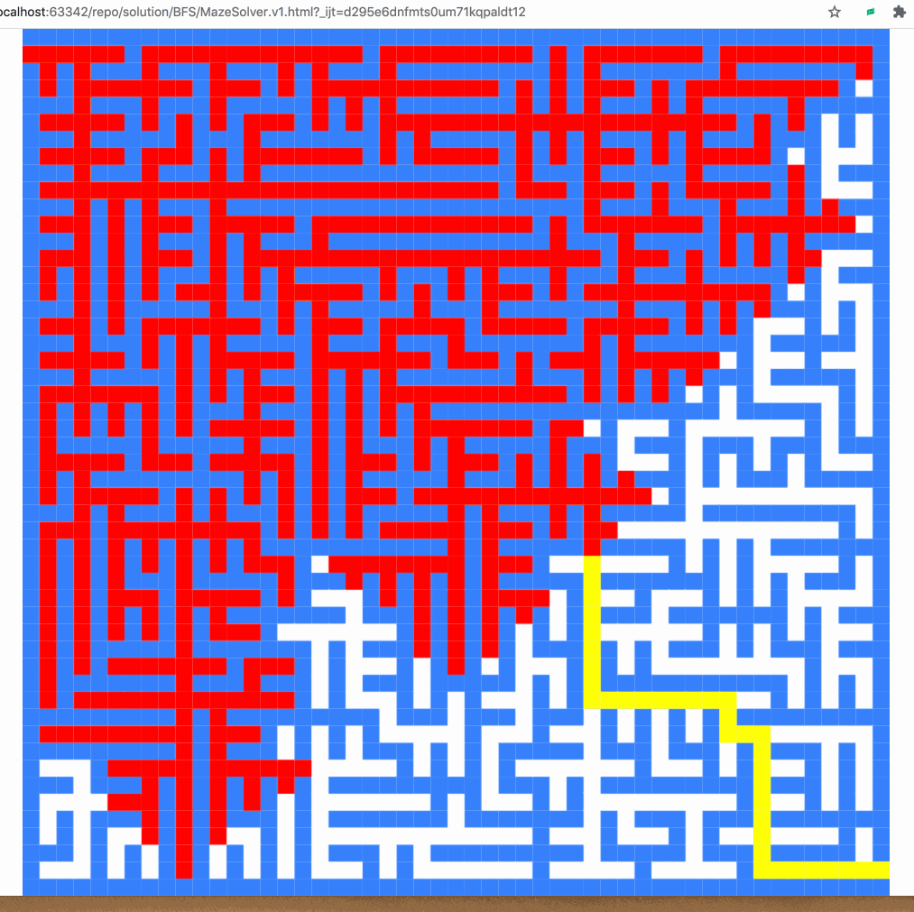
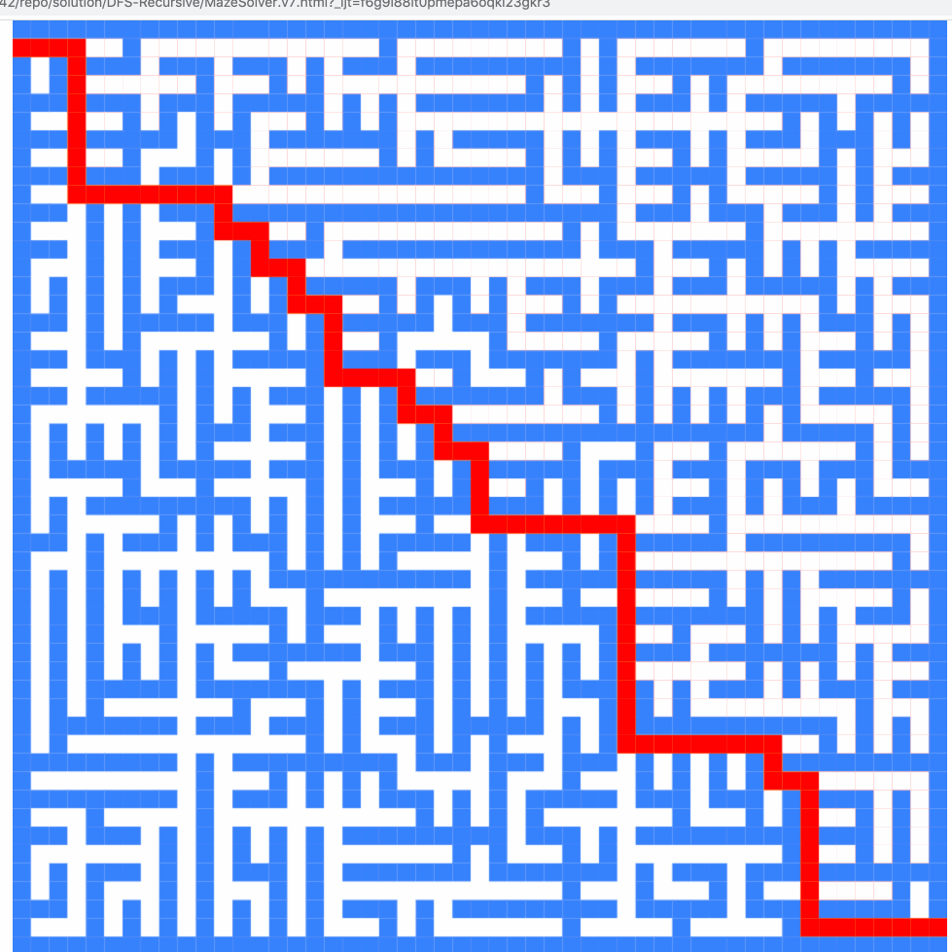
breadth-first vs. (pre-order) depth-first

Slide 519
breadth-first vs. (pre-order) depth-first
0
0
1
2
3
1
2
3
4
5
4
5
6
6
0
1
2
3
4
5
6
0
1
4
6
5
2
3

Slide 520
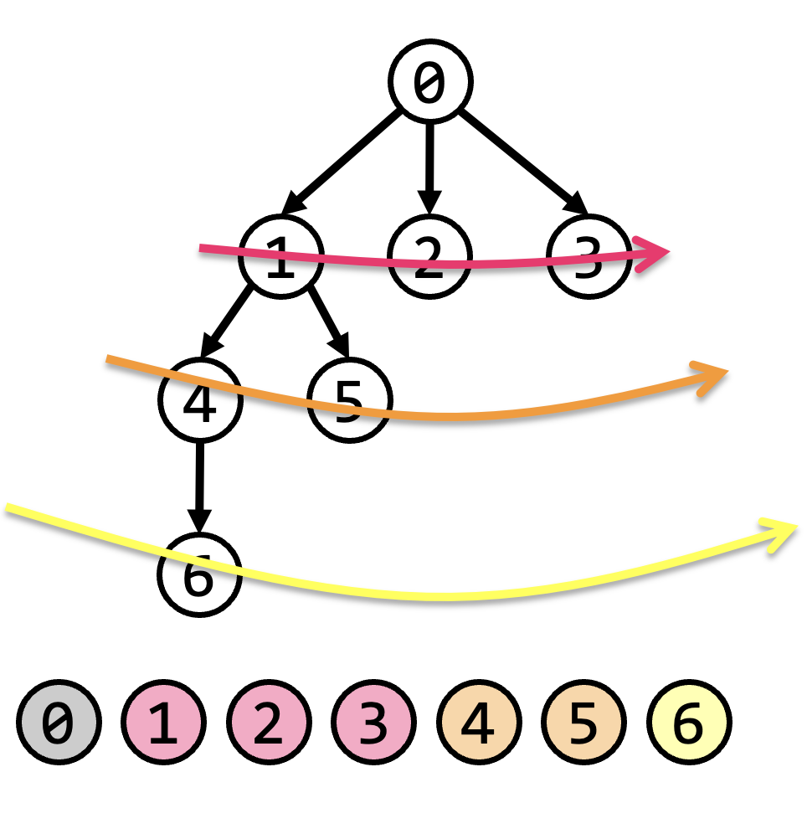
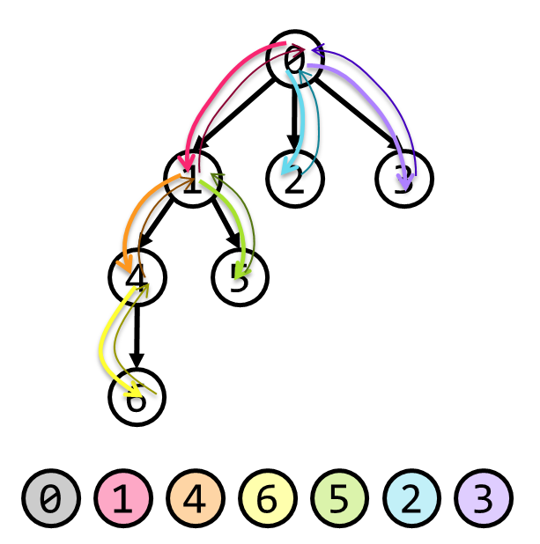
tree traversal (walking the tree)
tree traversal means iterating through all of the tree's nodes
breadth-first first explores as broadly (widely) as possible
one level (depth) at a time
uses a queue
depth-first first explores as deeply as possible
one root-to-leaf path at a time
uses a stack (or recursion, which uses the callstack)
☠ there are actually many different variants of depth-first traversal (i will explain them when we get to binary trees)

Slide 521
why might we want to traverse a tree? why did we want to traverse a linked list? do we ever *traverse* an array?

Slide 522
gathering all words in a trie (HW09)
searching for something (HW10?)
evaluating an expression tree
gathering all the nodes into a list (Tut09)

Slide 523
Terrific Tree Traversal Tutorial

Slide 524
explanation

Slide 525
Week09c
Friday.
trees vs. graphs
WARMUP
have you ever played the game Worms World Party?
how would you implement it?

Slide 526
[record lecture]

Slide 527
Terrific Tree Traversal Tutorial treview

Slide 528
traverseBreadthFirst
change color to indicate
hasBeenVisited = true
0 added to queue
0 removed from queue
1 added to queue
2 added to queue
3 added to queue
1 removed from queue
4 added to queue
5 added to queue
2 removed from queue
3 removed from queue
6 added to queue
4 removed from queue
5 removed from queue
6 removed from queue
7 added to queue
7 removed from queue
0
1
2
3
4
5
6
queue.add(root)
while queue not empty:
curr = queue.remove()
... # process curr
for child in curr.children:
queue.add(child)
7
0
1
2
3
4
5
6
7

Slide 529
traversePreOrderDepthFirst
change color to indicate
hasBeenVisited = true
start recurse(0)
start recurse(1)
start recurse(4)
finish recurse(4)
start recurse(5)
finish recurse(5)
finish recurse(1)
start recurse(2)
finish recurse(2)
start recurse(3)
start recurse(6)
start recurse(7)
finish recurse(7)
finish recurse(6)
finish recurse(3)
finish recurse(0)
0
1
2
3
4
5
6
def recurse(curr):
... # process curr
for child in curr.children:
recurse(child)
7
recurse(root)
0
1
4
5
2
3
6
7

Slide 530
example: two a-maze-ing mazes

Slide 531
maze A

Slide 532
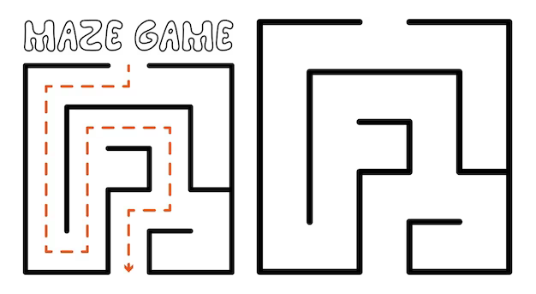

start
finish

Slide 564
maze B

Slide 565
start
finish

Slide 566
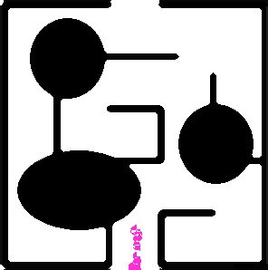

Slide 568
[worms world party]

Slide 569
trees vs. graphs

Slide 570
the problem with naively traversing a graph

Slide 571
directed cycles (loops) in the graph will create infinite loops in your code

Slide 572
[example (live coding)]
0
1
2
3

Slide 573
how to traverse a graph

Slide 574
to traverse a graph, you need to keep track of which nodes you have visited
Option A: Store a boolean called hasBeenVisited on each Node.
Option B: Use another data structure to keep track of visited nodes.
for example, HashMap<Node, Boolean> hasNodeBeenVisited;
or even better (smaller), HashSet<Node> visitedNodes;

Slide 575
example: traversing a graph with a directed cycle
1
2
3

Slide 576
example: flood fill 🪣

Slide 577
quadtree rabbit hole 🐰

Slide 578
problem: naive collision detection is slow O(n^2) to check all pairs

Slide 579
idea: use a grid O(n) to assign all circles to grid cells

Slide 580
problem: so many grid cells; most empty!

Slide 581
idea: "only have grid where you need it"

Slide 582
problem: how do we store this?

Slide 583
idea: a tree

Slide 584
idea: a tree

Slide 585
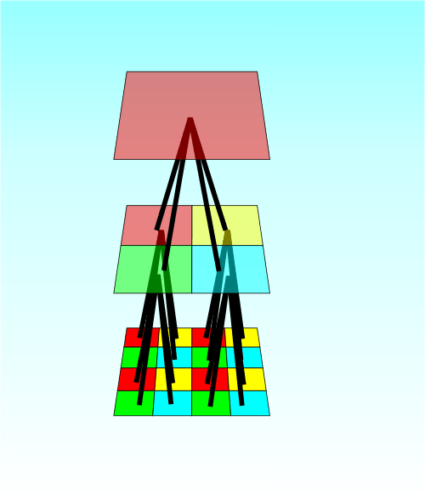

Slide 586
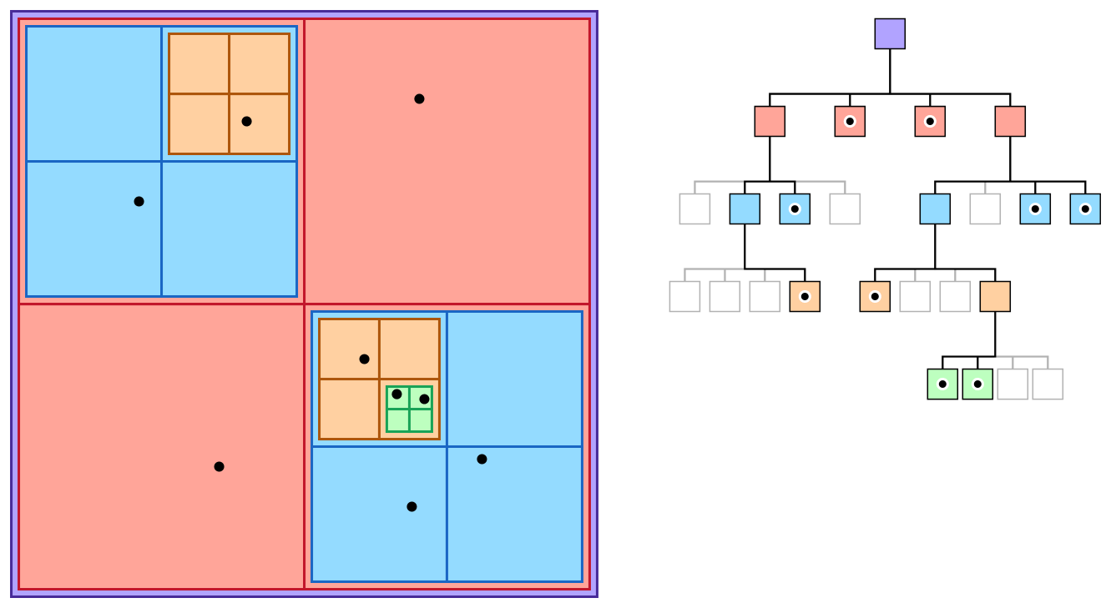

Slide 587
quadtree reading

Slide 588
Week08a
ANNOUNCEMENTS today is No Laptop Monday!
WARMUP "a chain is only as strong as its weakest link"
- what does this expression mean?
- what is a chain?
- what is a link?
- is this true for real-world metal chains? why or why not?
TODAY linked lists
🦜🦜🦜🦜🦜🦜🦜🦜

Slide 589


Slide 590
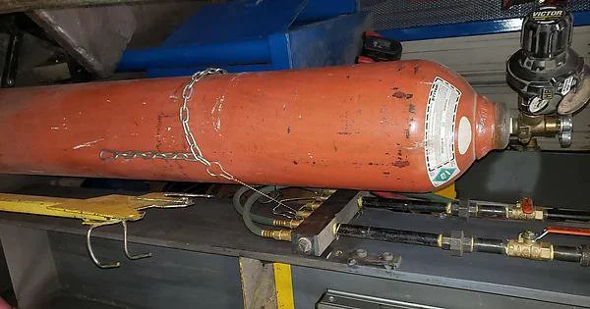

Slide 591
linked lists
record lecture

Slide 592
(p)review: list interface

Slide 593
list interface
// Get the element with this index.
ElementType get(int index);
// Add (append) an element to the back of the list. void add();
// Add (insert) an element into the list so it has this index void add(int index, ElementType element);
// Remove (delete) the element in the list at this index. void remove(int index);
// Get the number of elements currently in the list. int size();

Slide 594
list interface (cont.)
// NOTE: Many other functions could be included // in this interface.
void sort(); // Sort the list.
void reverse(); // Reverse the list.
List<ElementType> sorted(); // Get sorted copy of the list.
List<ElementType> reversed(); // Get reversed copy of list.
// Get index of first element with this value. int find(ElementType element);
...

Slide 595
a few weeks ago, we implemented the list interface using an array the array list

Slide 596
this week, we will implement the list interface using nodes with "links" (references) to other nodes this will be called a linked list

Slide 597
note

Slide 598
today we will be discussing the simplest possible linked list (LinkedList literally just has a reference to Node head.)

Slide 599
🐍
3.0
head
|
|
head.next
|
|
|
|
|
null

Slide 600
some other implementations are possible. some will be faster than this one.

Slide 601
for linked lists, do NOT memorize big O runtimes out of context

Slide 602
why are we doing this?

Slide 603
A: it will be cool to see two very different implementations of the same interface ☃️

Slide 604
B: linked lists will prepare us for trees and graphs🌳

Slide 605
C: linked lists are incredibly FUNdaMENTAL 🥳 (for us, as fundamental as arrays)

Slide 606
D: linked lists are actually big O better (than array lists) in very specific cases

Slide 607
E: linked lists are actually really, really important (especially in the C programming language)

Slide 608
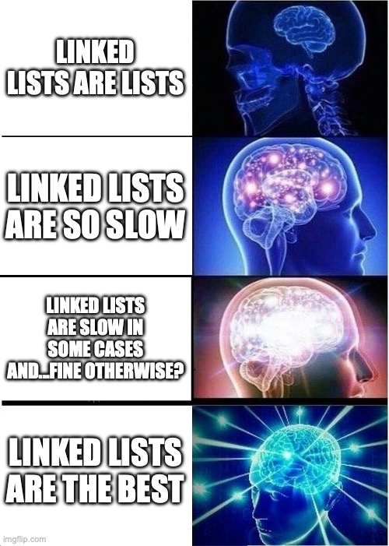

Slide 609
linked list

Slide 611
1.0
2.0
3.0

Slide 612
3.0
1.0
2.0

Slide 613
linked list
LinkedList list = new LinkedList();
class LinkedList {
Node head;
}
list.head = new Node(1.0);
1.0
class Node {
Value value;
Node next;
Node(Value value) {
this.value = value;
}
}
list.head.next = new Node(2.0);
1.0
2.0
list.head.next.next = new Node(3.0);
1.0
2.0
3.0

Slide 614
linked list
LinkedList list = new LinkedList();
class LinkedList {
Node head;
void add(Value value) {
...
}
}
list.add(1.0);
1.0
list.add(2.0);
1.0
2.0
class Node {
Value value;
Node next;
Node(Value value) {
this.value = value;
}
}
list.add(3.0);
1.0
2.0
3.0

Slide 615
example: addFront(value)

Slide 616
addFront(2.0)
value
next
value
next
3.0
4.0 | null
head

Slide 617
addFront(2.0)
3.0
4.0 | null
head

Slide 618
addFront(2.0)
Node tmp = new Node(2.0);
2.0 | null
3.0
4.0 | null
tmp
head

Slide 619
addFront(2.0)
2.0 | null
3.0
4.0 | null
tmp
head

Slide 620
addFront(2.0)
tmp.next = head;
2.0
3.0
4.0 | null
tmp
head

Slide 621
addFront(2.0)
2.0
3.0
4.0 | null
tmp
head

Slide 622
addFront(2.0)
head
head = tmp;
2.0
3.0
4.0 | null
tmp

Slide 623
addFront(2.0)
head
2.0
3.0
4.0 | null
tmp

Slide 624
addFront(2.0)
head
2.0
3.0
4.0 | null
// tmp leaves scope
tmp

Slide 625
addFront(2.0)
head
2.0
3.0
4.0 | null

Slide 626
same thing but with labels instead of arrows for head and tmp

Slide 627
addFront(2.0)
head
3.0
4.0 | null

Slide 628
addFront(2.0)
Node tmp = new Node(2.0);
tmp
head
2.0 | null
3.0
4.0 | null

Slide 629
addFront(2.0)
tmp
head
2.0 | null
3.0
4.0 | null

Slide 630
addFront(2.0)
tmp.next = head;
tmp
head
2.0
3.0
4.0 | null

Slide 631
addFront(2.0)
tmp
head
2.0
3.0
4.0 | null

Slide 632
addFront(2.0)
head = tmp;
head
2.0
3.0
4.0 | null

Slide 633
addFront(2.0)
head
2.0
3.0
4.0 | null

Slide 634
head
2.0
3.0
4.0 | null

Slide 635
2.0
3.0
4.0
(even) more abstract diagram

Slide 636
example: remove

Slide 637
remove
prev
curr
curr.next
3.0
4.0
5.0
Node prev = null; // the previous node
Node curr = head; // the current node
while (...) {
...
prev = curr;
curr = curr.next;
}

Slide 638
remove
prev
curr
curr.next
3.0
4.0
5.0

Slide 639
remove
prev
curr
curr.next
3.0
4.0
5.0

Slide 640
remove
prev.next = curr.next;
prev
curr
curr.next
3.0
4.0
5.0

Slide 641
remove
prev.next = curr.next;
prev
curr
curr.next
3.0
4.0
5.0

Slide 642
remove
prev.next = curr.next;
prev
curr.next
3.0
5.0

Slide 643
remove
3.0
5.0

Slide 644
remove
3.0
5.0

Slide 645
where did the middle node go? - way back when...we created it using new - then we just like..."stopped referring to it" - is it gone now? 😥

Slide 646
🚛it has been garbage collected

Slide 647
[board discussion of "no directed path from stack to the node"]

Slide 648
big O runtimes

Slide 649
what is the big O runtime of size()? [pointing activity]

Slide 650
O(n) 😢

Slide 651
singly-linked list worst case runtimes
head
list.add(index, value)
// O(n)
list.removeByIndex(index)
// O(n)
list.size()
// O(n)
list.addFront() // list.add(0, value)
// O(1)
list.removeFront() // list.removeByIndex(0)
// O(1)
list.addBack()
// O(n)
list.removeBack()
// O(n)

Slide 652
beyond big O runtime

Slide 653

what does this actually look like in memory?
1.0
2.0
3.0

Slide 654
class LinkedList {
Node head;
}
list
LinkedList list = new LinkedList();
list.head = new Node(1.0);
list.head.next = new Node(2.0);
list.head.next.next = new Node(3.0);
0x0a2bcefa
class Node {
double value;
Node next;
}
0x2349d47a3
1.0 0x05287a12
3.0 null
2.0 0xab334b19

Slide 655
1.0 0x05287a12
3.0 null
2.0 0xab334b19

Slide 656
what does this mean? cons? ☹️ pros? 🙂 (how is this very different than an array list?)

Slide 657
https://x.com/_kzr/status/1672497446705037312

Slide 658
class LinkedList {
Node head;
}
List list = new List();
list.head = new Node("Hans");
list.head.next = new Node("The");
list.head.next.next = new Node("Parrot");
list
class Node {
String value;
Node next;
}
0x0a2bcefa
'H' 'a' 'n' 's'
0x2349d47a3
'T' 'h' 'e'
0x234c8b7a 0x05287a12
0x7766231a null
0x3425ff1a 0xab334b19
'P' 'a' 'r' 'r' 'o' 't'

Slide 660
ANNOUNCEMENTS friday's colloquium will be cool!
my friend Pascal makes ✨underwater robotic spheres✨!
midterms will be returned Fri
WARMUP review: for a linked list, size() is O(n) runtime
- how could you make size() (or perhaps... size) O(1)?
-- is this at all...spooky?👻
TODAY size() and riffs on linked lists
Week08b
🦜🦜🦜🦜🦜🦜🦜🦜

Slide 661
🐍
3.0
the front of the snek
head
|
|
head.next
|
|
|
|
the back of the snek
|
null

Slide 662
linked lisssssst

Slide 663
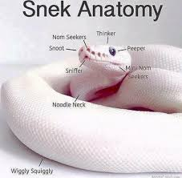

Slide 664
[record lecture]

Slide 665
LinkedList review

Slide 666
runtimes

Slide 667
worst case singly-linked list runtimes
head
list.add(index, value)
// O(n)
list.removeByIndex(index)
// O(n)
list.size()
// O(n)
list.addFront()
// O(1)
list.removeFront()
// O(1)
list.addBack()
// O(n)
list.removeBack()
// O(n)

Slide 668
additional warmup: prepending a list

Slide 669
example
Node snap = new Node(1.0);
Node crackle = new Node(2.0);
Node pop = new Node(3.0);
snap.next = crackle;
crackle.next = pop;
pop.next = head;
head = snap;
✍️
4.0
5.0
head

Slide 670
example
Node snap = new Node(1.0);
Node crackle = new Node(2.0);
Node pop = new Node(3.0);
snap.next = crackle;
crackle.next = pop;
pop.next = head;
head = snap;
4.0
5.0
head

Slide 671
example
Node snap = new Node(1.0);
Node crackle = new Node(2.0);
Node pop = new Node(3.0);
snap.next = crackle;
crackle.next = pop;
pop.next = head;
head = snap;
snap
1.0 | null
4.0
5.0
head

Slide 672
example
Node snap = new Node(1.0);
Node crackle = new Node(2.0);
Node pop = new Node(3.0);
snap.next = crackle;
crackle.next = pop;
pop.next = head;
head = snap;
snap
crackle
1.0 | null
2.0 | null
4.0
5.0
head

Slide 673
example
Node snap = new Node(1.0);
Node crackle = new Node(2.0);
Node pop = new Node(3.0);
snap.next = crackle;
crackle.next = pop;
pop.next = head;
head = snap;
snap
crackle
pop
1.0 | null
2.0 | null
3.0 | null
4.0
5.0
head

Slide 674
example
Node snap = new Node(1.0);
Node crackle = new Node(2.0);
Node pop = new Node(3.0);
snap.next = crackle;
crackle.next = pop;
pop.next = head;
head = snap;
snap
crackle
pop
1.0
2.0 | null
3.0 | null
4.0
5.0
head

Slide 675
example
Node snap = new Node(1.0);
Node crackle = new Node(2.0);
Node pop = new Node(3.0);
snap.next = crackle;
crackle.next = pop;
pop.next = head;
head = snap;
snap
crackle
pop
1.0
2.0
3.0 | null
4.0
5.0
head

Slide 676
example
Node snap = new Node(1.0);
Node crackle = new Node(2.0);
Node pop = new Node(3.0);
snap.next = crackle;
crackle.next = pop;
pop.next = head;
head = snap;
snap
crackle
pop
1.0
2.0
3.0
4.0
5.0
head

Slide 677
example
Node snap = new Node(1.0);
Node crackle = new Node(2.0);
Node pop = new Node(3.0);
snap.next = crackle;
crackle.next = pop;
pop.next = head;
head = snap;
snap
crackle
pop
1.0
2.0
3.0
4.0
5.0
head

Slide 678
example
Node snap = new Node(1.0);
Node crackle = new Node(2.0);
Node pop = new Node(3.0);
snap.next = crackle;
crackle.next = pop;
pop.next = head;
head = snap;
1.0
2.0
3.0
4.0
5.0
head

Slide 679
🧠 was that faster than calling addFront() n times? 🧠 same big O or different big O? (if we were to call it many times)
Node snap = new Node(1.0);
Node crackle = new Node(2.0);
Node pop = new Node(3.0);
snap.next = crackle;
crackle.next = pop;
pop.next = head;
head = snap;
addFront(3.0);
addFront(2.0);
addFront(1.0);
vs.

Slide 680
🧠 was that faster than calling addFront() n times? yes (only updated head once) 🧠 same big O or different big O? same (still have to "hook up" O(n) references)

Slide 681
[implement LinkedList]

Slide 682
[implement LinkedList]

Slide 683
size()

Slide 684
[ implement size() poorly ]

Slide 685
[ implement size() poorly ]

Slide 686
joyful implementation of size

Slide 687
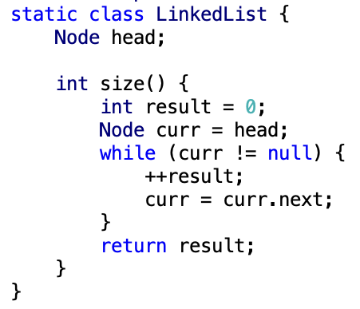

Slide 688
size()
what is the big O runtime of this method?
O(n) ☹️
this seems like a pretty steep cost to pay just to know the list’s size... what would be a more efficient approach?
store size as an instance variable
update it every time you change the number of elements in the list (inside of add, remove, etc.)
what is the runtime of this approach?
O(1) 🙂

Slide 689
while way more efficient, this approach is perhaps a bit spooky 👻 multiple functions are now also responsible for carefully modifying an instance variable (mess up, and any code that depends on size will be very weirdly broken)

Slide 690
note: the A homework doesn't use size at all

Slide 691
but if you were going to implement/use the list's size... i would start with size() as a function, get everything working perfectly, and only then carefully turn it into an instance variable 🙂👍

Slide 692


(it's this thing again)

Slide 693
tail reference

Slide 694
singly-linked list with reference to tail
head
tail
class LinkedList {
Node head;
Node tail;
}
class Node {
Value value;
Node next;
}

Slide 695
singly-linked list with reference to tail worst case runtimes
head
tail
list.add(index, value)
// O(n)
list.removeByIndex(index)
// O(n)
list.size()
// O(n)
list.addFront()
// O(1)
list.removeFront()
// O(1)
list.addBack()
// O(1) 😀
list.removeBack()
// O(n) 😡

Slide 696
doubly-linked list

Slide 697
singly- vs. doubly-linked

Slide 698
singly-linked list
head
class LinkedList {
Node head;
}
class Node {
Value value;
Node next;
}

Slide 699
doubly-linked list
tail
head
class LinkedList2 {
Node2 head;
Node2 tail;
}
class Node2 {
Value value;
Node2 next;
Node2 prev;
}

Slide 700
🤷
3.0
4.0
5.0

Slide 701
3.0
4.0
5.0

Slide 702
runtimes

Slide 703
worst case doubly-linked list runtimes
tail
head
list.add(index, value)
// O(n)
list.removeByIndex(index)
// O(n)
list.size()
// O(n)
list.addFront()
// O(1)
list.removeFront()
// O(1)
list.addBack()
// O(1) 😀
list.removeBack()
// O(1) 😀

Slide 704
a doubly-linked list is a great way to implement a deque (double-ended queue)
O(1) addFront() O(1) removeFront() O(1) addBack() O(1) removeBack()
🧠 could you pull this off with an array list?
no.
addFront() is O(n)
🧠 could you pull this off with an array?
sort of!—the array deque (amortized O(1) add)

Slide 705
Week08c
warmup: have you pre-registered? what classes are you taking?
🦜
underwater robotic spheres!
colloquium today in Wege (TCL123)
@ 2:30pm

Slide 706
pre-reg

Slide 707
237

Slide 708


Slide 709
"the stack"
local variable primitives & references to Objects
undefined by default (will NOT compile if used)
"the heap"
the actual Objects (arrays and String's count as Objects)
cleared to 0 or null by default

Slide 711
LinkedList list =
new LinkedList("Hans -> Parrot");

Slide 712
LinkedList list;
{
Node node;
String string;
list = new LinkedList();
node = new Node();
string = "Hans";
node.value = string;
list.head = node;
node = new Node();
string = "Parrot";
node.value = string;
list.head.next = node;
}

Slide 713
LinkedList list;
{
Node node;
String string;
list = new LinkedList();
node = new Node();
string = "Hans";
node.value = string;
list.head = node;
node = new Node();
string = "Parrot";
node.value = string;
list.head.next = node;
}
list
UNDEFINED

Slide 714
LinkedList list;
{
Node node;
String string;
list = new LinkedList();
node = new Node();
string = "Hans";
node.value = string;
list.head = node;
node = new Node();
string = "Parrot";
node.value = string;
list.head.next = node;
}
list
node
UNDEFINED
UNDEFINED

Slide 715
LinkedList list;
{
Node node;
String string;
list = new LinkedList();
node = new Node();
string = "Hans";
node.value = string;
list.head = node;
node = new Node();
string = "Parrot";
node.value = string;
list.head.next = node;
}
list
node
string
UNDEFINED
UNDEFINED
UNDEFINED

Slide 716
LinkedList list;
{
Node node;
String string;
list = new LinkedList();
node = new Node();
string = "Hans";
node.value = string;
list.head = node;
node = new Node();
string = "Parrot";
node.value = string;
list.head.next = node;
}
list
node
string
0x11111111
UNDEFINED
UNDEFINED
null

Slide 717
LinkedList list;
{
Node node;
String string;
list = new LinkedList();
node = new Node();
string = "Hans";
node.value = string;
list.head = node;
node = new Node();
string = "Parrot";
node.value = string;
list.head.next = node;
}
list
node
string
0x11111111
0x22222222
UNDEFINED
null
null null

Slide 718
LinkedList list;
{
Node node;
String string;
list = new LinkedList();
node = new Node();
string = "Hans";
node.value = string;
list.head = node;
node = new Node();
string = "Parrot";
node.value = string;
list.head.next = node;
}
list
node
string
0x11111111
0x22222222
0x88888888
null
null null
H a n s

Slide 719
LinkedList list;
{
Node node;
String string;
list = new LinkedList();
node = new Node();
string = "Hans";
node.value = string;
list.head = node;
node = new Node();
string = "Parrot";
node.value = string;
list.head.next = node;
}
list
node
string
0x11111111
0x22222222
0x88888888
null
0x88888888 null
H a n s

Slide 720
LinkedList list;
{
Node node;
String string;
list = new LinkedList();
node = new Node();
string = "Hans";
node.value = string;
list.head = node;
node = new Node();
string = "Parrot";
node.value = string;
list.head.next = node;
}
list
node
string
0x11111111
0x22222222
0x88888888
0x22222222
0x88888888 null
H a n s

Slide 721
LinkedList list;
{
Node node;
String string;
list = new LinkedList();
node = new Node();
string = "Hans";
node.value = string;
list.head = node;
node = new Node();
string = "Parrot";
node.value = string;
list.head.next = node;
}
list
node
string
0x11111111
0x33333333
0x88888888
0x22222222
0x88888888 null
null null
H a n s

Slide 722
LinkedList list;
{
Node node;
String string;
list = new LinkedList();
node = new Node();
string = "Hans";
node.value = string;
list.head = node;
node = new Node();
string = "Parrot";
node.value = string;
list.head.next = node;
}
list
node
string
0x11111111
0x33333333
0x99999999
0x22222222
0x88888888 null
null null
H a n s
P a r r o t

Slide 723
LinkedList list;
{
Node node;
String string;
list = new LinkedList();
node = new Node();
string = "Hans";
node.value = string;
list.head = node;
node = new Node();
string = "Parrot";
node.value = string;
list.head.next = node;
}
list
node
string
0x11111111
0x33333333
0x99999999
0x22222222
0x88888888 null
0x99999999 null
H a n s
P a r r o t

Slide 724
LinkedList list;
{
Node node;
String string;
list = new LinkedList();
node = new Node();
string = "Hans";
node.value = string;
list.head = node;
node = new Node();
string = "Parrot";
node.value = string;
list.head.next = node;
}
list
node
string
0x11111111
0x33333333
0x99999999
0x22222222
0x88888888 0x33333333
0x99999999 null
H a n s
P a r r o t

Slide 725
LinkedList list;
{
Node node;
String string;
list = new LinkedList();
node = new Node();
string = "Hans";
node.value = string;
list.head = node;
node = new Node();
string = "Parrot";
node.value = string;
list.head.next = node;
}
list
0x11111111
0x22222222
0x88888888 0x33333333
0x99999999 null
H a n s
P a r r o t

Slide 726
LinkedList list;
{
Node node;
String string;
list = new LinkedList();
node = new Node();
string = "Hans";
node.value = string;
list.head = node;
node = new Node();
string = "Parrot";
node.value = string;
list.head.next = node;
}
list
0x11111111
0x22222222
0x88888888 0x33333333
0x99999999 null
H a n s
P a r r o t

Slide 727
memory in C

Slide 728
in C, we often get to choose whether to allocate memory on the stack or the heap

Slide 729
memory allocation
// Java
int[] heapAllocatedArray = new int[10]
heapAllocatedArray[0] = 3;
// C
int stackAllocatedArray[10];
int *heapAllocatedArray = malloc(10000000 * sizeof(int));
stackAllocatedArray[0] = 3;
heapAllocatedArray[0] = 3;
free(heapAllocatedArray);

Slide 730
256

Slide 731


Slide 732
334

Slide 733


Slide 734


Slide 735
something fun?

Slide 736
fun friday menu - jim rants about comments and syntax highlighting - jim continues codeing (some of) microsoft paint from scratch - jim updates you on his CAD software - jim show and tells about his favorite element - jim reads aloud from grugbrain.dev - jim reads aloud from vim creep - jim reads aloud from hexing the technical interview - jim reads aloud from the truth about lisp - jim reads aloud from the worst API ever made

Slide 737
midterm

Slide 738
common areas of struggle

Slide 739
question 1
syntax
list.add(int 3); // void add(int element);
True
}

Slide 740
}
generally speaking {
you want your curly braces {
}
to look {
something like this {
}
}
}

Slide 741
}
generally speaking
{
you want your curly braces
{
}
to look
{
something like this
{
}
}
}

Slide 742
}
this is quite spooky {
and hard {
to read }
it's hard to tell {
where one scope starts {
and the next ends
}}
do i have enough braces?

Slide 743
question 3
control flow
returning too early (inside for loop)
handling special case too late (after creating array)
if...if vs. if...else if vs. if...else
syntax
list[i]
null
boolean 7Found;
;

Slide 744
question 5
complete understanding of app
pool
single enemy vs. multiple enemies

Slide 745
question 6
complete understanding of app
buffer is 8 characters long, but only length many characters are drawn
last question

Slide 746
results

Slide 747
summay
distribution is very wide (this is normal)
some grades are low (< ~50)
this does not mean you will fail the coure
"if you do all the homework, and the exams just aren't working for you, you will pass CS136" – James Bern, Fri Nov 1
my comments are very sparse
if you don't know why you lost points, or you think i may have made a mistake please ask

Slide 748
mean: 86.4
standard deviation: 15.9

Slide 749
thoughts

